Slide 1
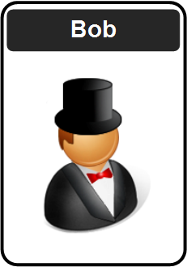
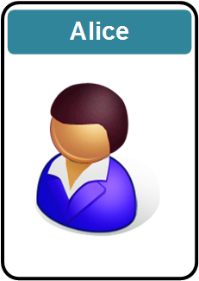


Cryptography
Prof Bill Buchanan OBE FRSE
https://asecuritysite.com

Slide 2
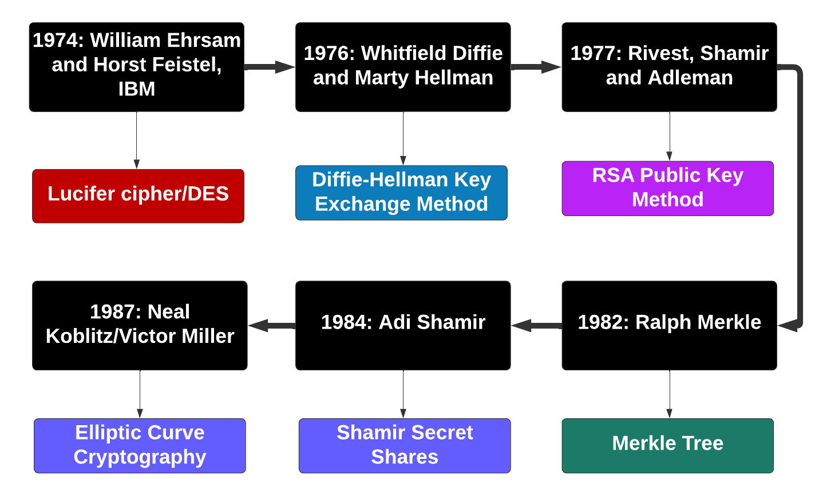
A Bit of History

Slide 3
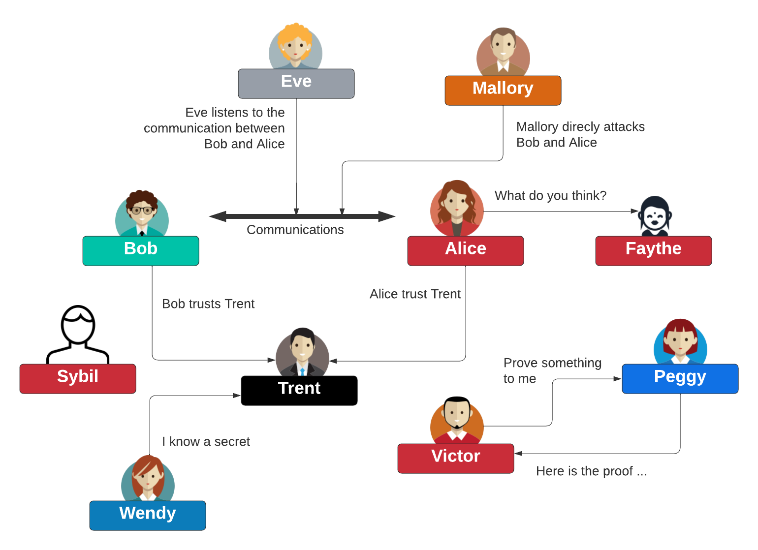
Some Actors

Slide 4
Cryptography: Fundamentals
Prof Bill Buchanan OBE FRSE
https://asecuritysite.com
Fundamentals
Symmetric Key
Hashing
MAC
KDF
Public Key
Key Exchange
Signatures
Digital Certificates

Slide 5
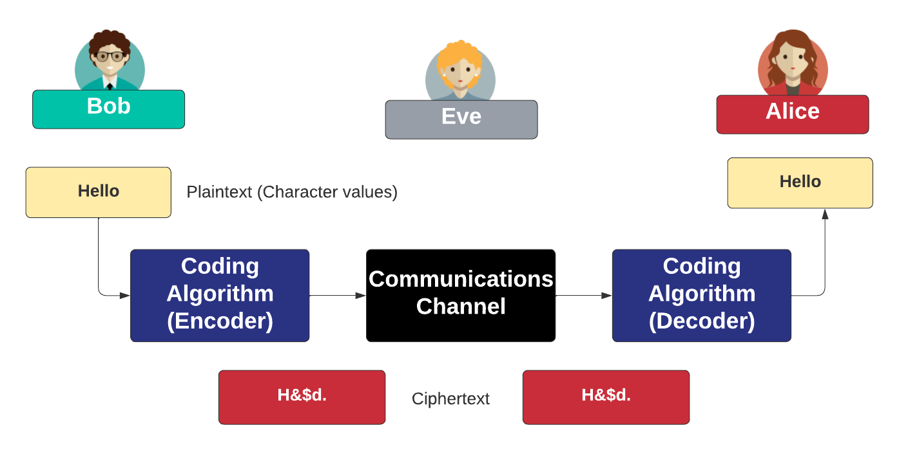
Encoding and Decoding

Slide 6
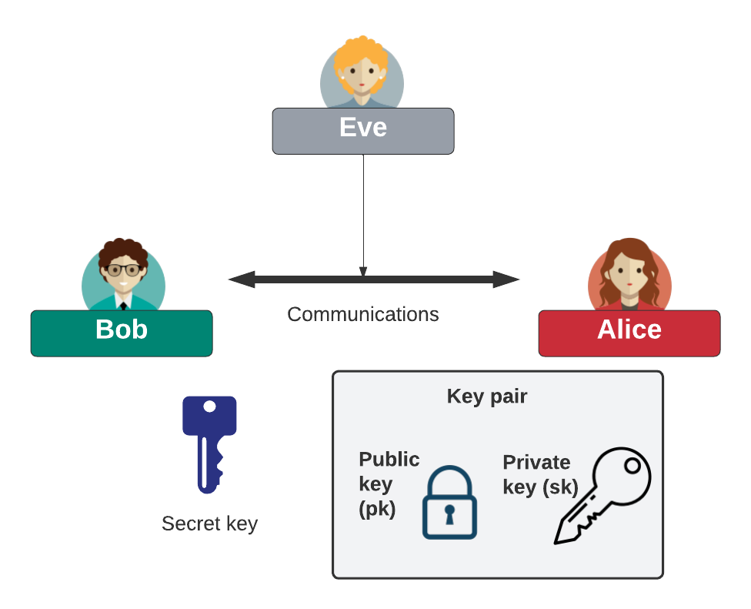
Keys

Slide 7
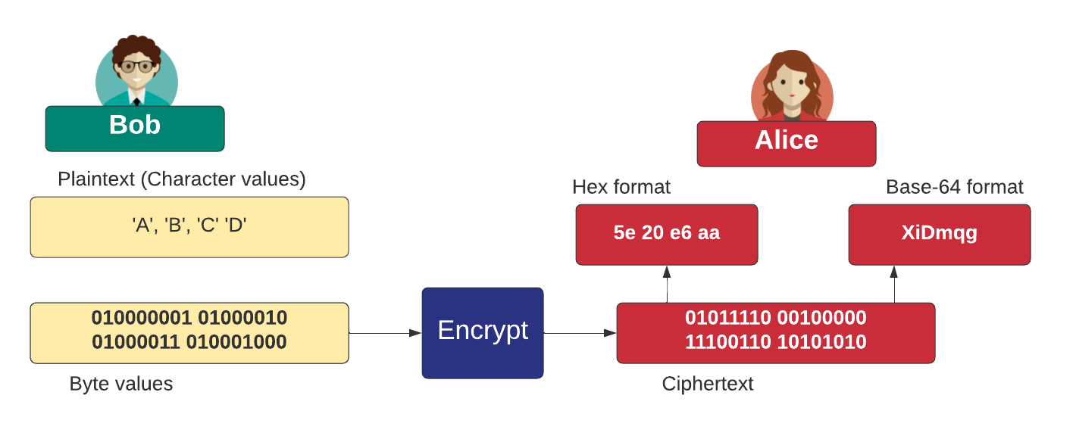
Encoding

Slide 8
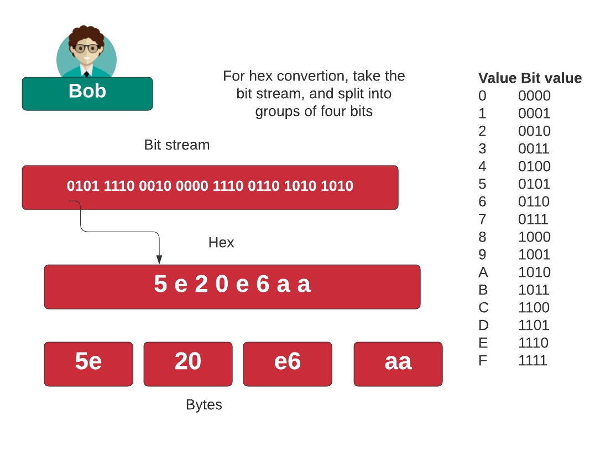
Hexadecimal

Slide 9
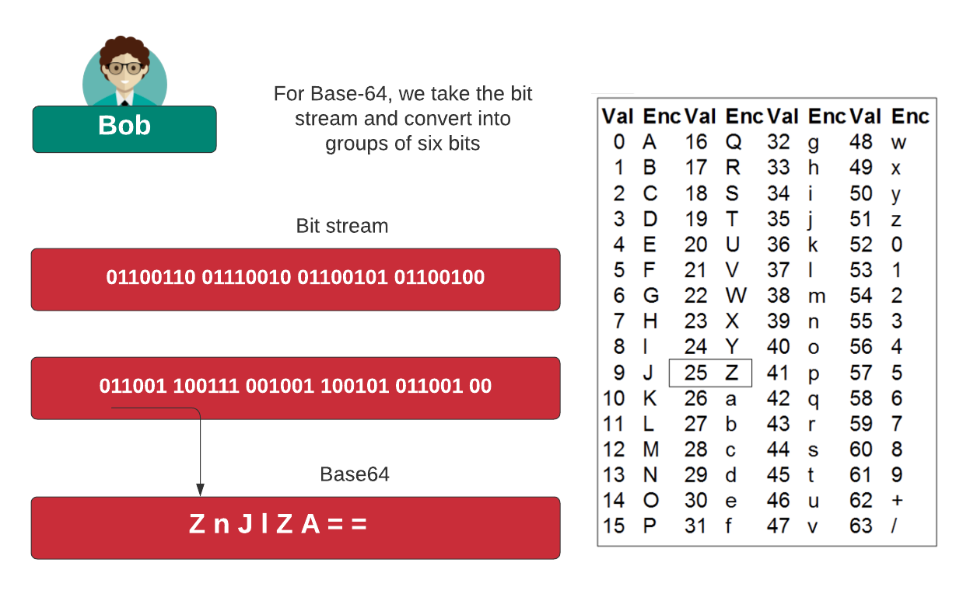
Base 64

Slide 10
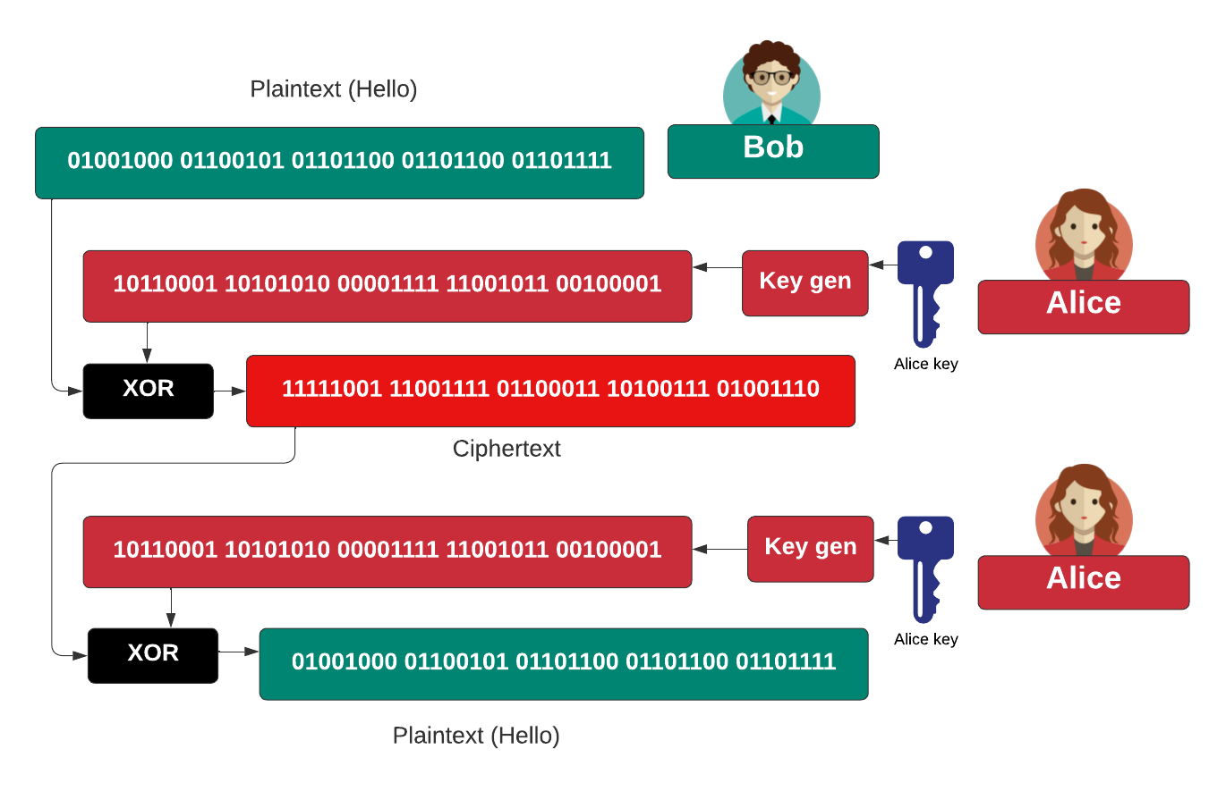
A Basic Operation

Slide 11
Cryptography: Symmetric Key
Prof Bill Buchanan OBE FRSE
https://asecuritysite.com/symmetric
Fundamentals
Symmetric Key
Hashing
MAC
KDF
Public Key
Key Exchange
Signatures
Digital Certificates

Slide 12
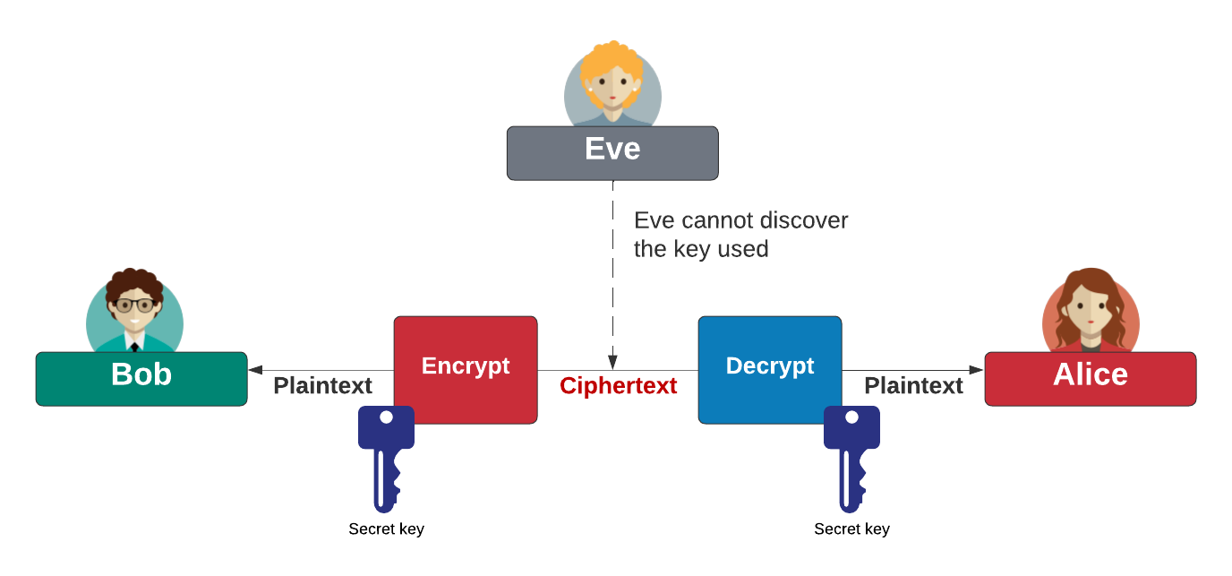
Symmetric Key
Block cipher: AES (128-bit block), DES (64-bit block), 3DES (64-bit block), Blowfish, SM4, Camellia, GOST, IDEA, RC2, Serpent, Skipjack, Twofish, and XTEA Stream cipher: ChaCha20, AES GCM, ARIA, Sala20, and RC4. AES also known as Rijndael (after Joan Daemen and Vincent Rijmen). ChaCha20 created by Daniel J Bernstein. Blowfish and Twofish created by Bruce Schneier.

Slide 13
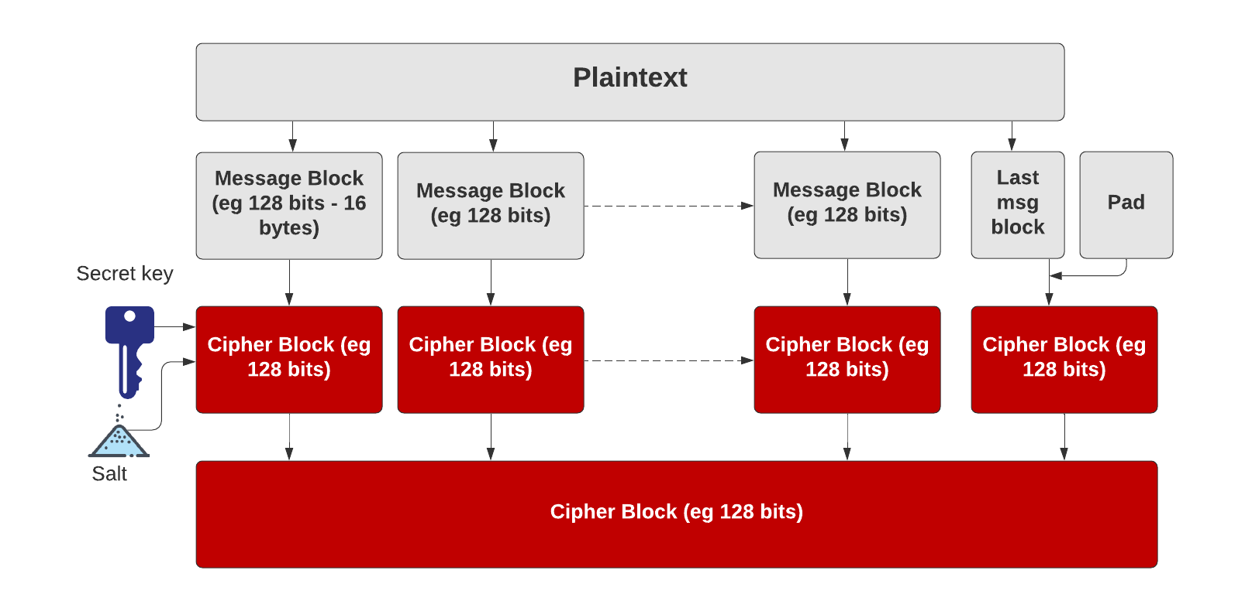
Symmetric Key – Block cipher
https://asecuritysite.com/golang/go_pad

Slide 14
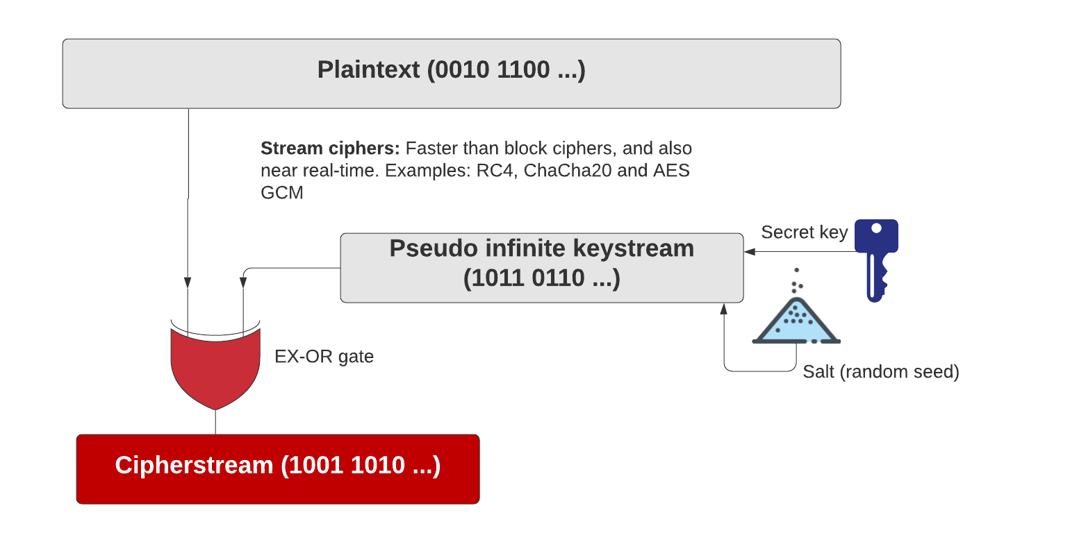
Symmetric Key – Stream cipher
https://asecuritysite.com/golang/go_chacha

Slide 15
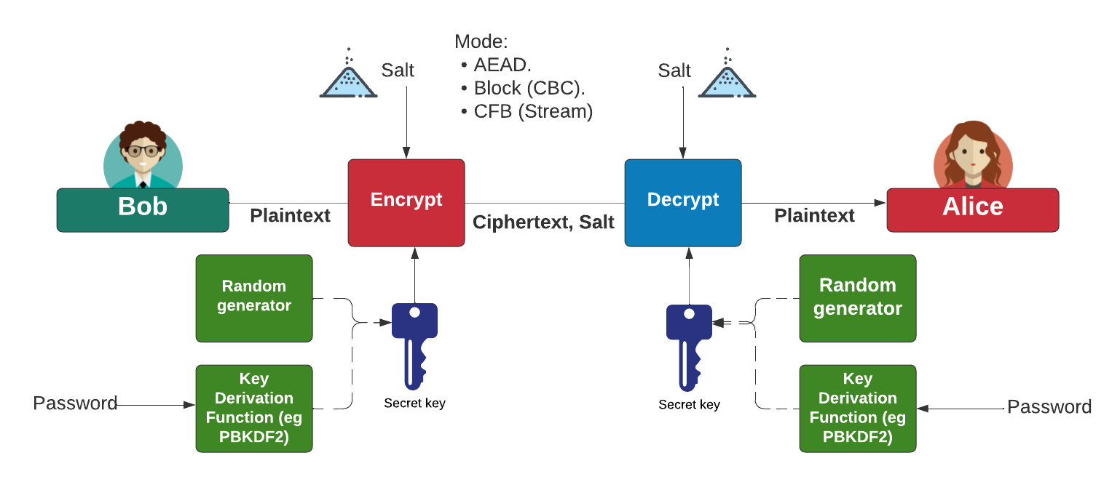
Symmetric Key - Modes
AES Block cipher modes: ECB (No salt), CBC (Cipher Block Chaining).
AES Stream modes: CFB (Cipher Feedback), OFB (Output Feedback), CTR (Counter), GCM (Galois Counter Mode).
https://asecuritysite.com/golang/go_symmetric

Slide 16
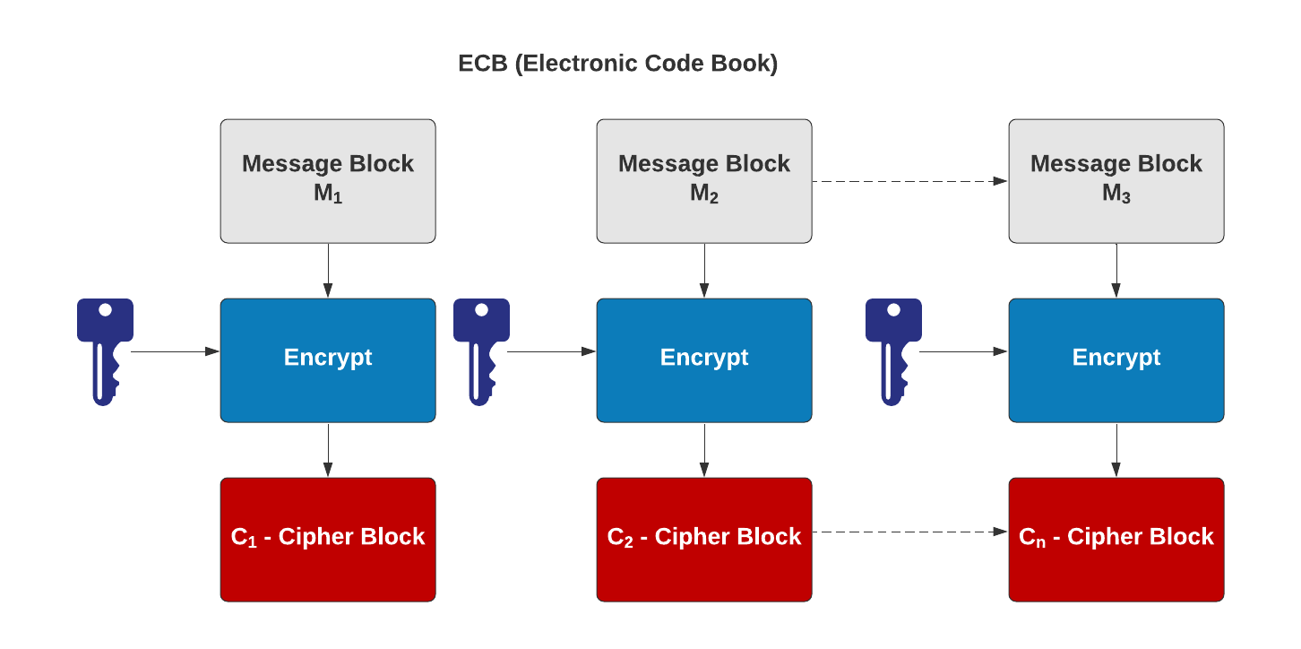
Symmetric Key – Electronic Code Code (ECB)
AES Block cipher modes: ECB (No salt), CBC (Cipher Block Chaining).
AES Stream modes: CFB (Cipher Feedback), OFB (Output Feedback), CTR (Counter), GCM (Galois Counter Mode).
https://asecuritysite.com/hazmat/hashnew4

Slide 17
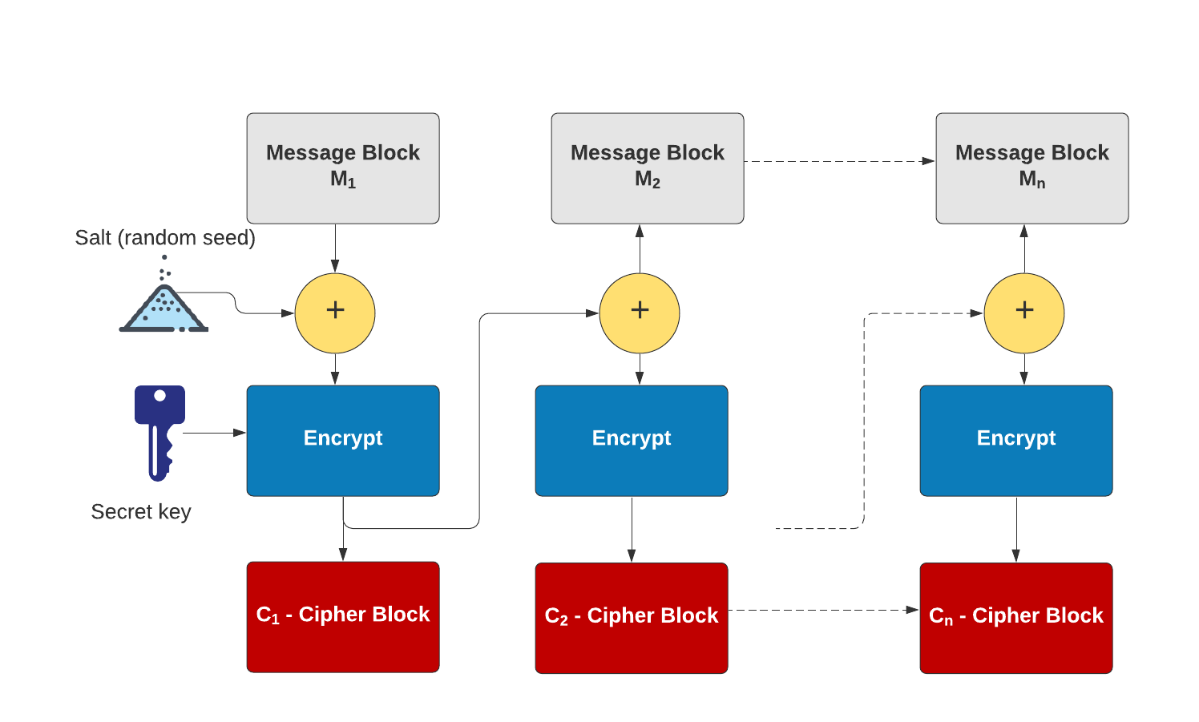
Symmetric Key – Cipher Block Chaining (CBC)
AES Block cipher modes: ECB (No salt), CBC (Cipher Block Chaining).
AES Stream modes: CFB (Cipher Feedback), OFB (Output Feedback), CTR (Counter), GCM (Galois Counter Mode).
https://asecuritysite.com/golang/go_symmetric

Slide 18
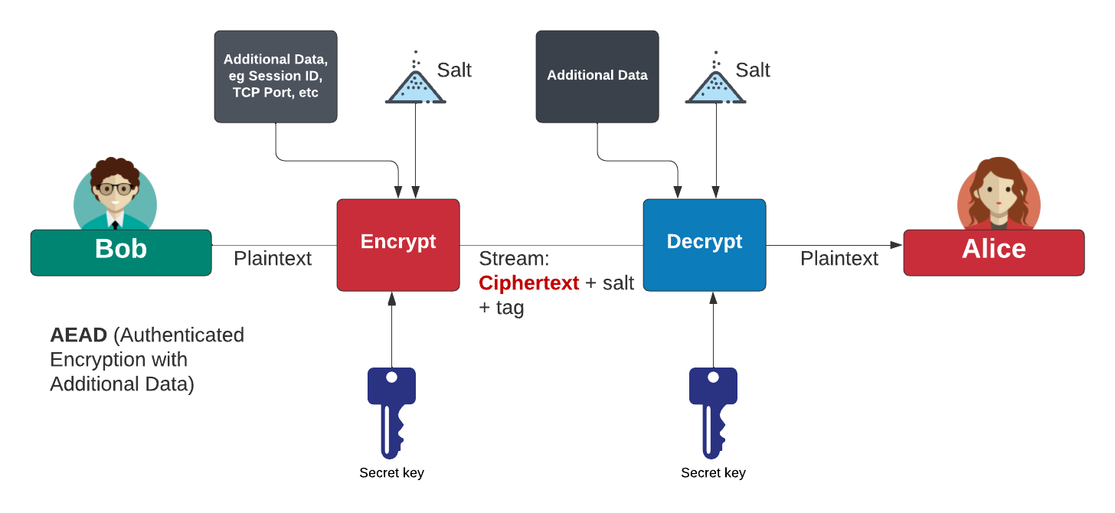
Authenticated Encryption with Additional Data (AEAD)
AES Block cipher modes: ECB (No salt), CBC (Cipher Block Chaining).
AES Stream modes: CFB (Cipher Feedback), OFB (Output Feedback), CTR (Counter), GCM (Galois Counter Mode).
https://asecuritysite.com/golang/go_symmetric

Slide 19
Cryptography: Hashing
Prof Bill Buchanan OBE FRSE
https://asecuritysite.com/hashing
Fundamentals
Symmetric Key
Hashing
MAC
KDF
Public Key
Key Exchange
Signatures
Digital Certificates

Slide 20
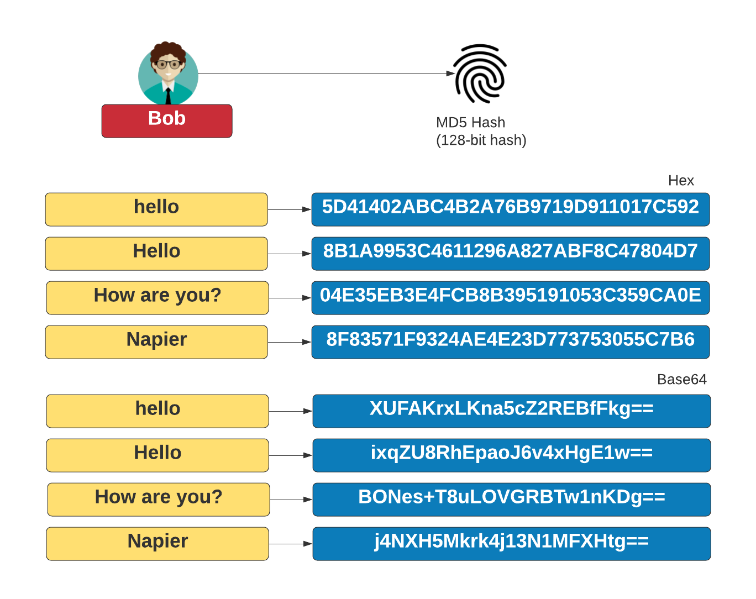
Hashing – MD5 (128-bit)
https://asecuritysite.com/hash/md5

Slide 21
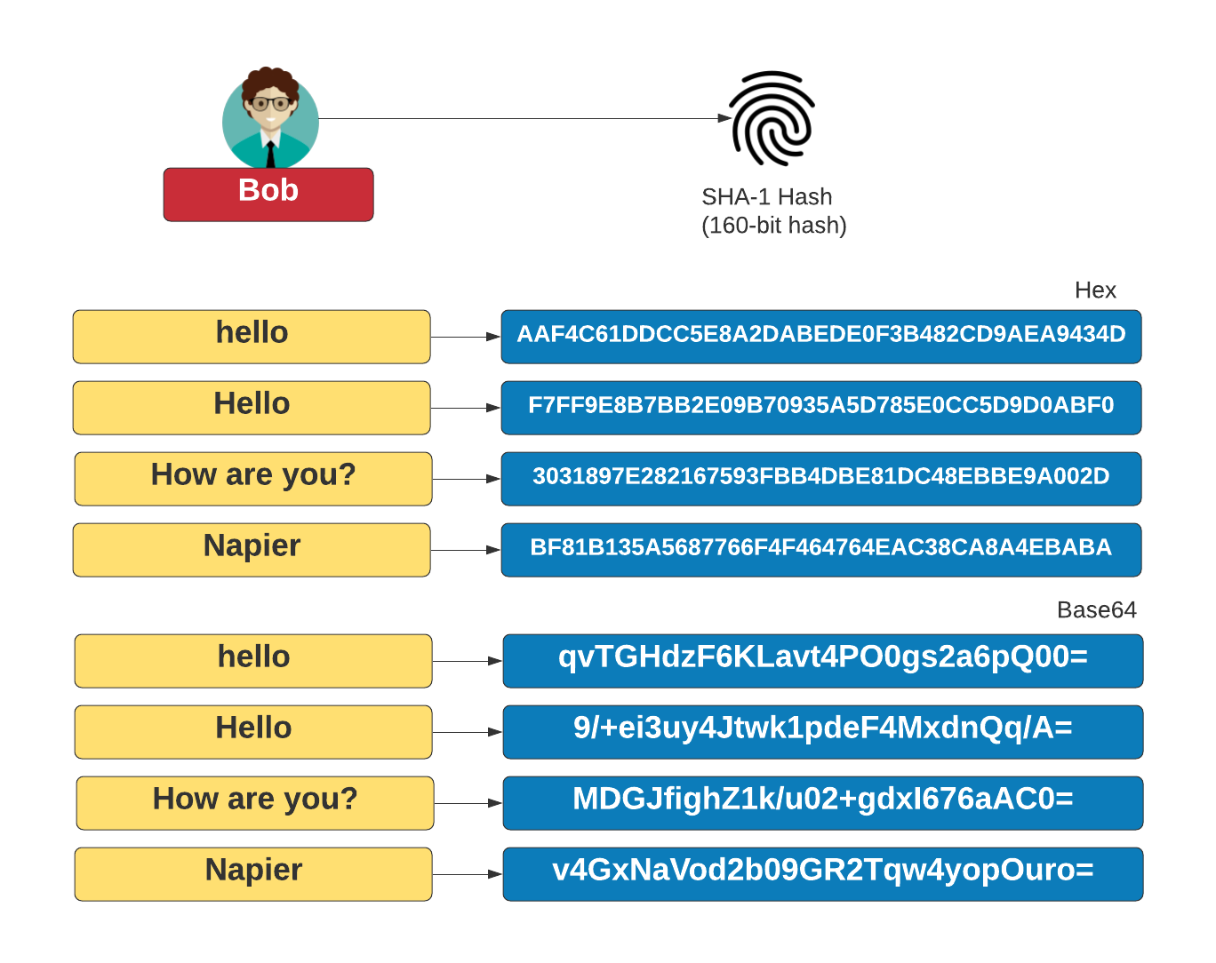
Hashing – SHA-1 (160-bit)
https://asecuritysite.com/hash/md5

Slide 22
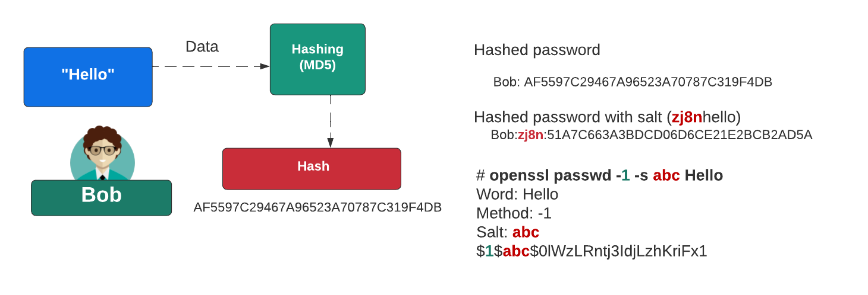
Password Hashing
Cryptographic Hashes: MD5, SHA-1, SHA-256, SHA-3, RIPEMD, Blake2b Windows hashes: NTLM
Non-cryptographic hashes: Spooky, Farm, FVN
https://asecuritysite.com/golang/gohash
https://asecuritysite.com/openssl/passwds

Slide 23
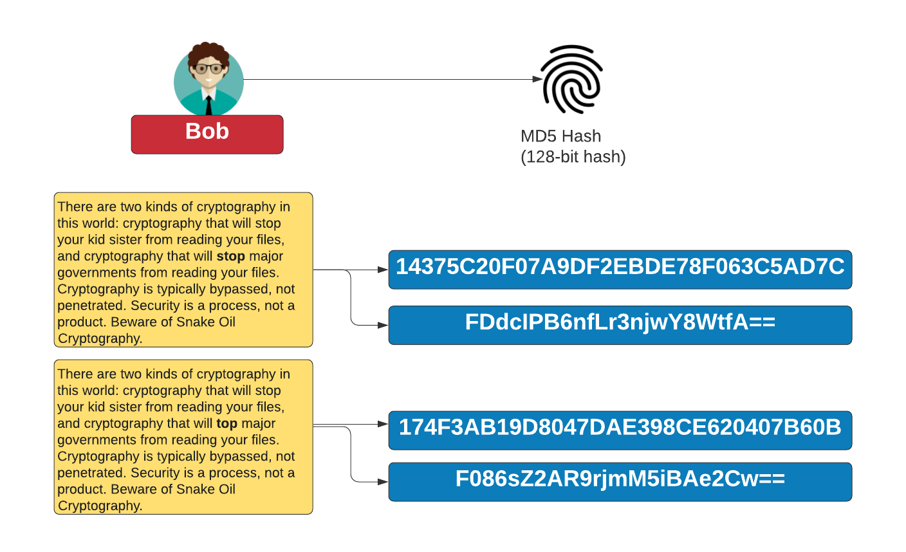
Hashing
https://asecuritysite.com/hash/hashnew

Slide 24
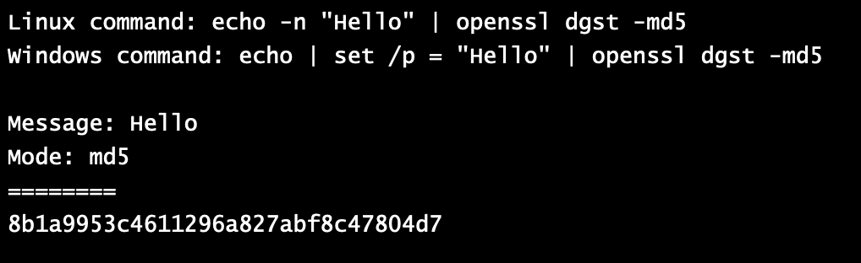
Hashing and OpenSSL
https://asecuritysite.com/openssl/openssl_full2b
https://asecuritysite.com/openssl/openssl_full2

Slide 25
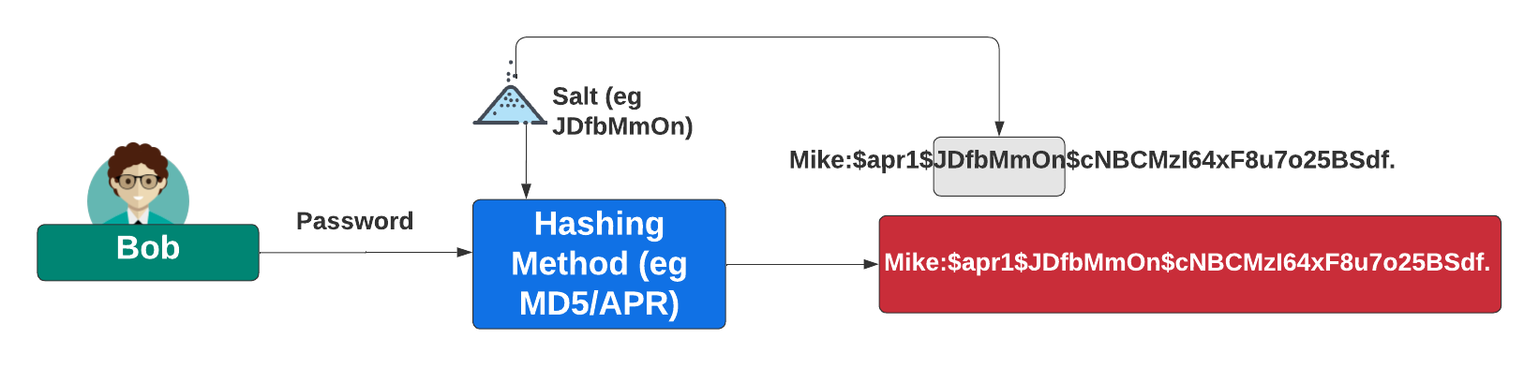
Adding Salt
https://asecuritysite.com/hash/salt

Slide 26
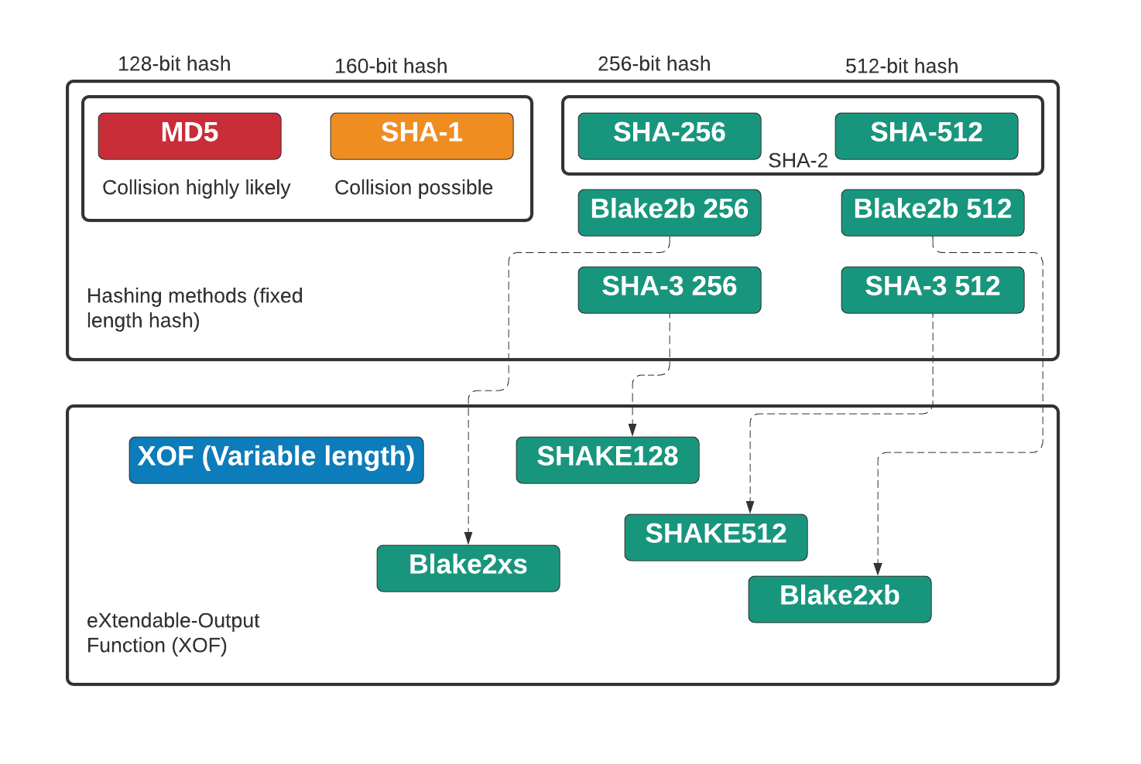
MD5, SHA-1, SHA-2, SHA-3 and XOF
https://asecuritysite.com/hash/cs

Slide 27
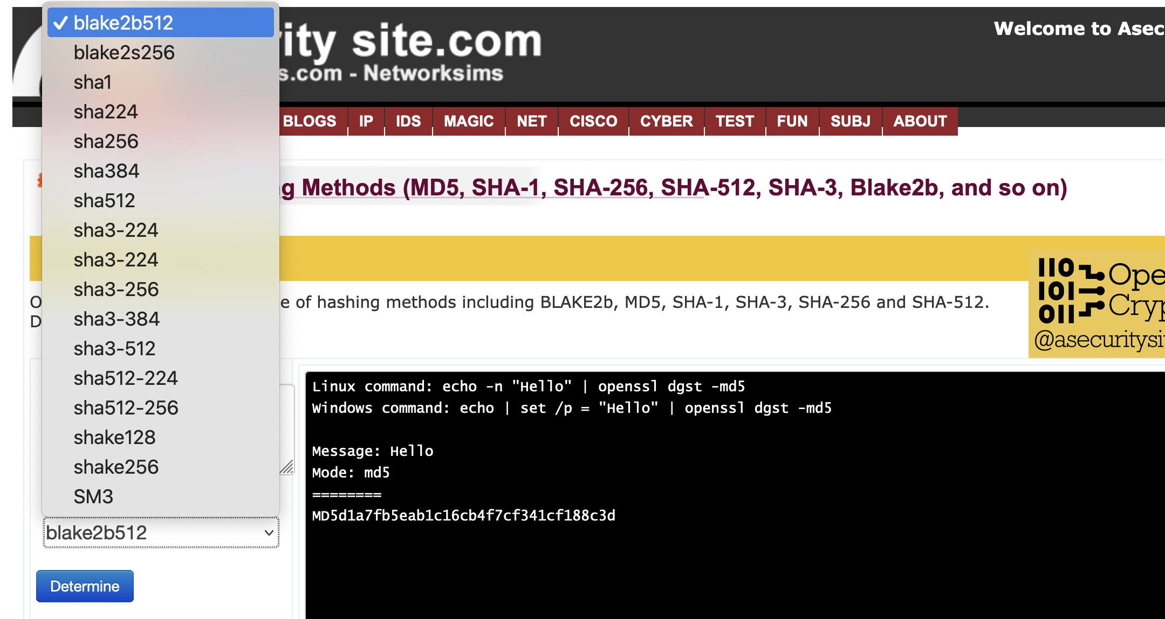
OpenSSL
https://asecuritysite.com/openssl/openssl_full2

Slide 28
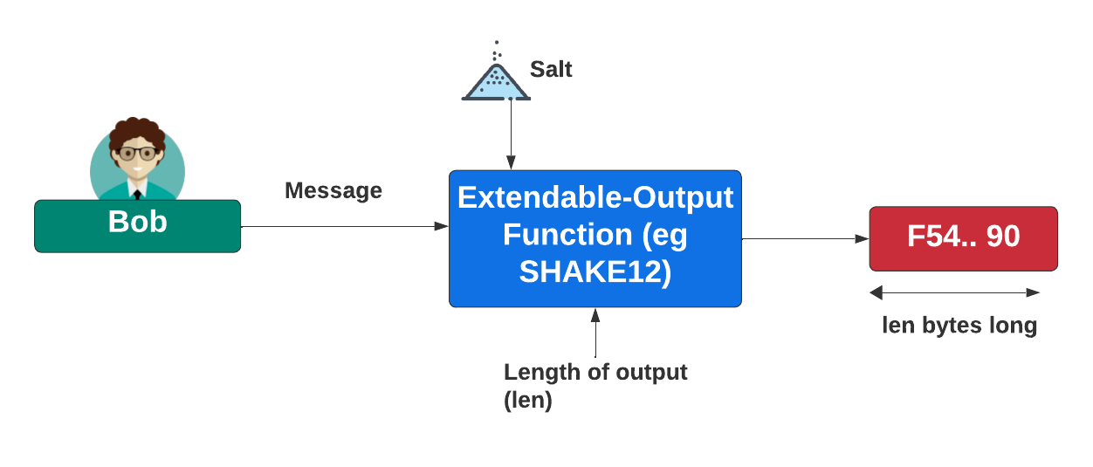
XOF
https://asecuritysite.com/hash/cs

Slide 29
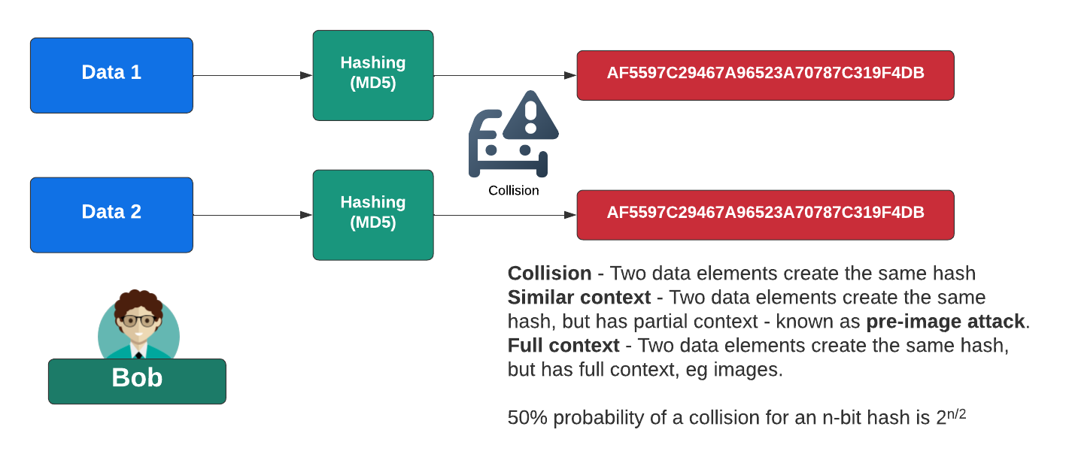
Hash Collisions

Slide 30
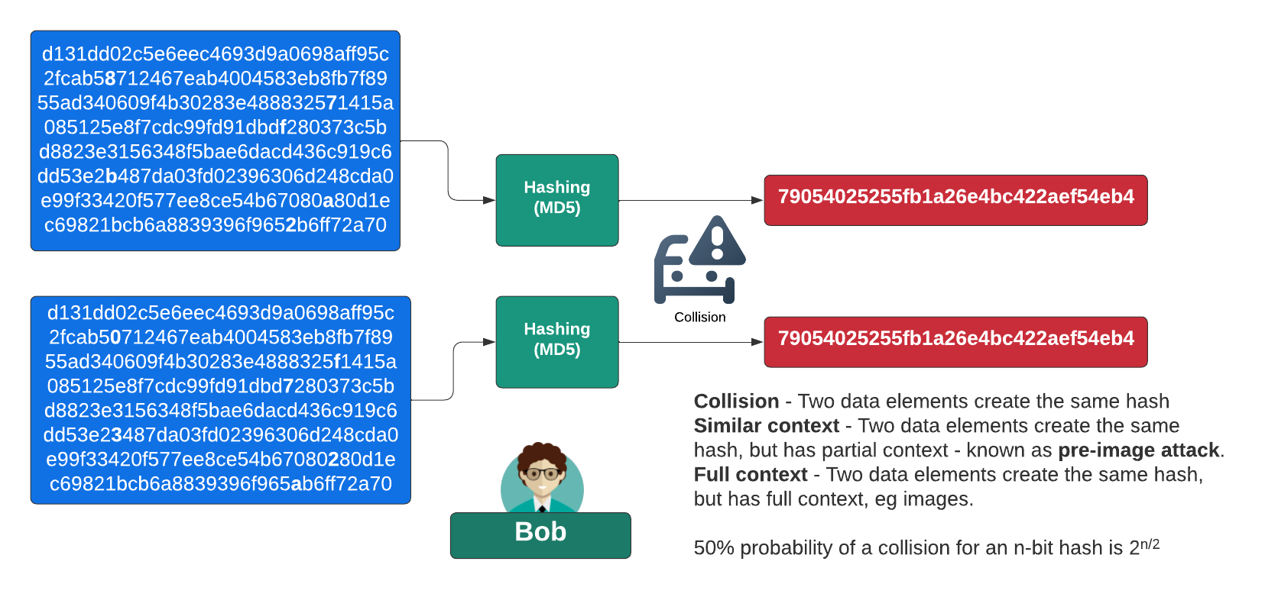
A Real Hash Collision Due To A Flaw

Slide 31
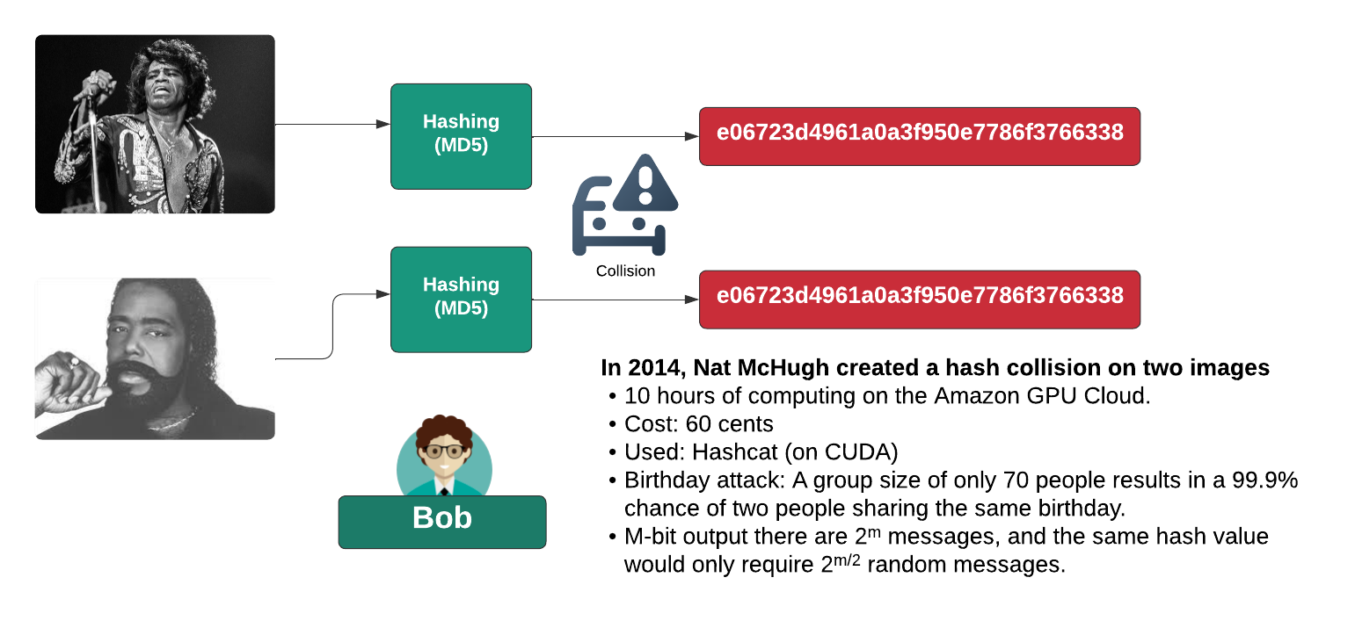
Hash Collision Using Birthday Attack

Slide 32
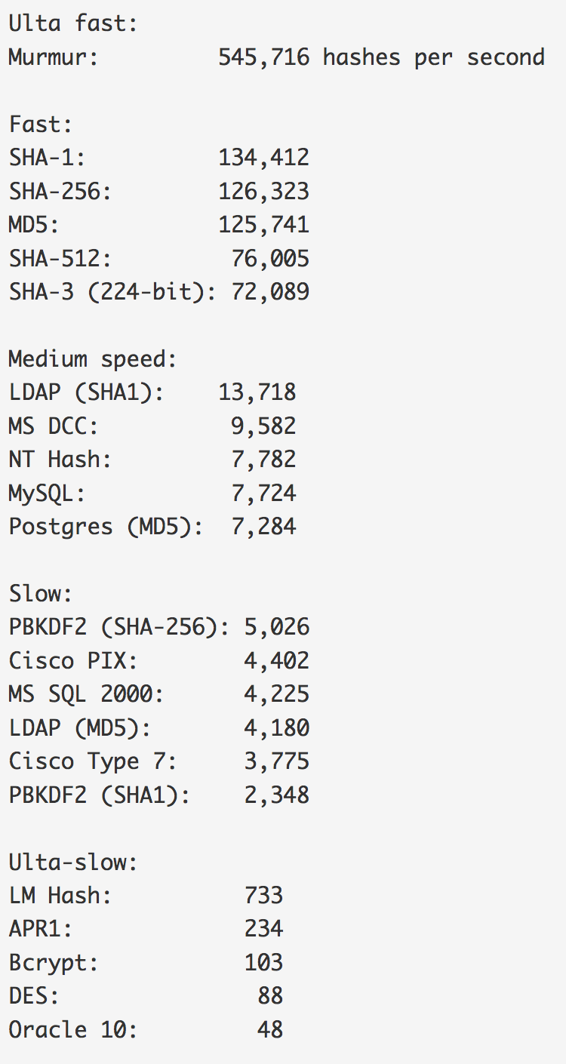
Benchmark
Hash Benchmarks
Hashes “The quick brown fox jumps over the lazy dog:
SHA-1: 2fd4e1c67a2d28fced849ee1bb76e7391b93eb12
SHA-256: d7a8fbb307d7809469ca9abcb0082e4f8d5651e46d3cdb762d02d0bf37c9e592
SHA-512: 07e547d9586f6a73f73fbac0435ed76951218fb7d0c8d788a309d7
85436bbb642e93a252a954f23912547d1e8a3b5ed6e1bfd7097821233fa0538f3db854fee6
MD-5: 9e107d9d372bb6826bd81d3542a419d6
DES: ZDeS94Lcq/6zg
Bcrypt: $2a$05$2czCv5GYgkx3aobmEyewB.ejV2hePMdbvTdCyNaSzWtlGPPjB2xx6
APR1: $apr1$ZDzPE45C$3PvRanPycmNc6c2G9wT9b/
PBKDF2 (SHA1): $pbkdf2$5$WkR6UEU0NUM$0RB2bimWrMY.EPYibpaBT2q3HFg
PBKDF2 (SHA-256): $pbkdf2-sha256$5$WkR6UEU0NUM$yrJz2oJix7uBJZwZ/50vWUgdE
I/i0ffqeU4obqC0pk4
LM Hash: a7b07f9948d8cc7f97c4b0b30cae500f
NT Hash: 4e6a076ae1b04a815fa6332f69e2e231
MS DCC: efa9778bbc94a7360f664eb7d7144725
LDAP (MD5): {MD5}9e107d9d372bb6826bd81d3542a419d6
LDAP (SHA1): {SHA}2fd4e1c67a2d28fced849ee1bb76e7391b93eb12
MS SQL 2000: 0x0100BF77CE595DCD1FC87A37B3DEBC27A8C97355CB96B8BAB
63E602662BA5D5D33B913E422499BE72FF3D9BB65DE
MySQL: *A4E4D26FD0C6455E23E2187C3AABE844332AA1B3
Oracle 10: 4CDA2299FCAD0499
Postgres (MD5): md5d44c15daa11770f25c5350f7e5408dd1
Cisco PIX: kGyKN5CqdFQ1qJUs
Cisco Type 7: 15260309443B3E2D2B3875200108010D41505640135E1B0E080
519574156401540035E460B594D1D53020B5C
Benchmark

Slide 33
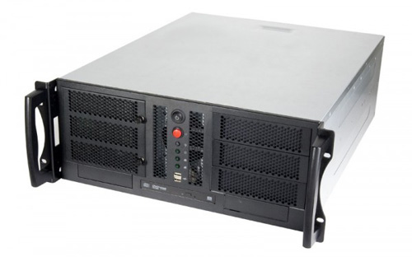
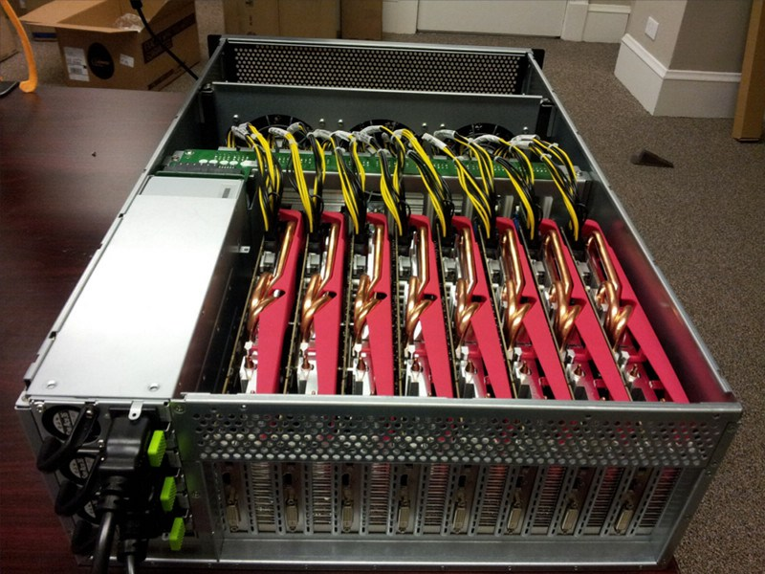
Hash Crackers/Bit Coin Miners
Fast Hash One
1.536TH/s – Cost 3-5,000 dollars.
25 GPU Hash Cracker
An eight character NTLM password cracked in 5.5 hours. 14 character LM hash cracked in six minutes. 350 billion hashes per second.

Slide 34
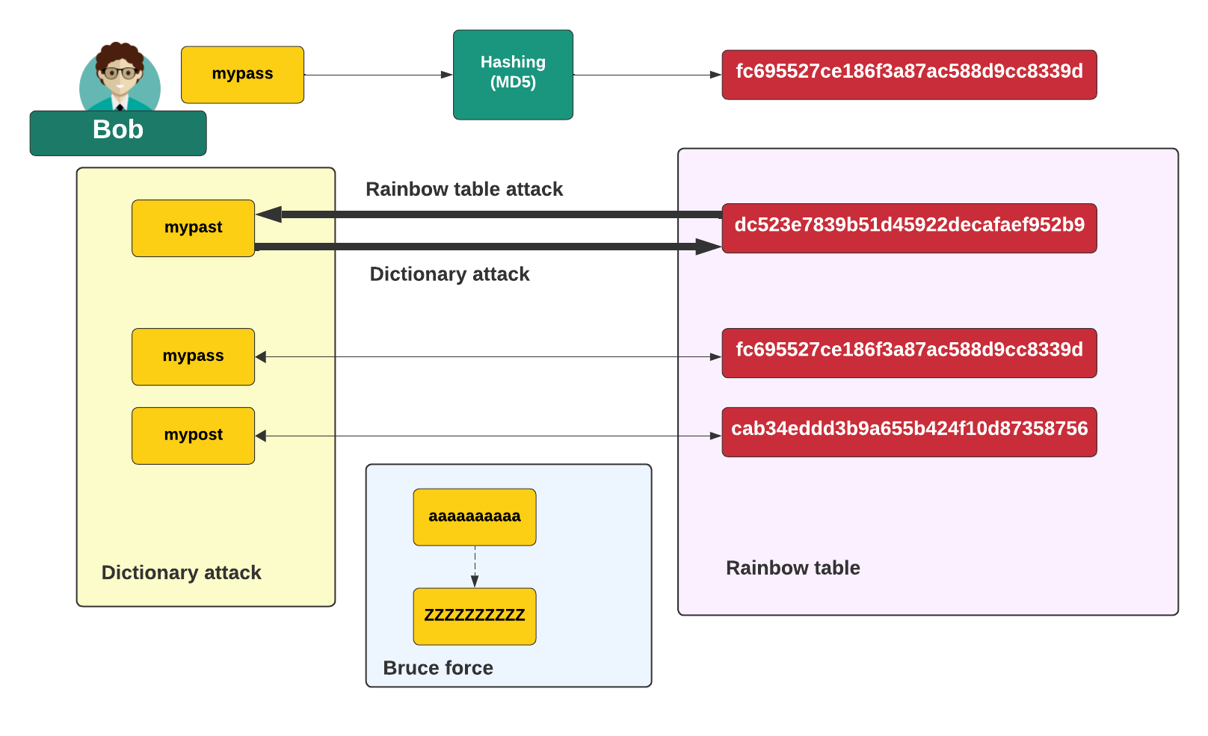
Cracking Methods

Slide 35
Brute Force - How many hash codes?
7 digit password with [a-z] … how many?
Ans:
Time to crack - 100 billion per second:
7 digit with [a-zA-z] … how many?
Ans:
Time to crack – 100 billion per second:
7 digit with [a-zA-z!@#$%^&*()] … how many?
Ans:
Time to crack – 100 billion per second:

Slide 36
Cryptography: MAC
Prof Bill Buchanan OBE FRSE
https://asecuritysite.com/mac
Fundamentals
Symmetric Key
Hashing
MAC
KDF
Public Key
Key Exchange
Signatures
Digital Certificates

Slide 37
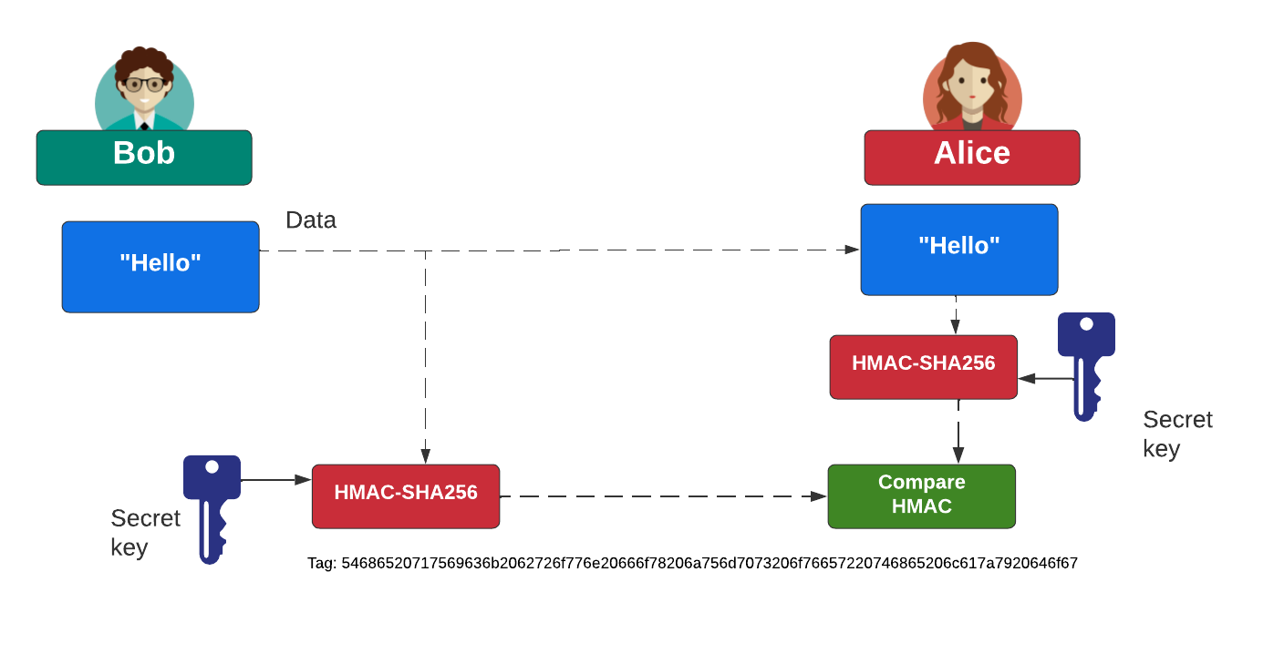
HMAC (Key Hash Message Authentication Code)
https://asecuritysite.com/mac/hashnew2

Slide 38
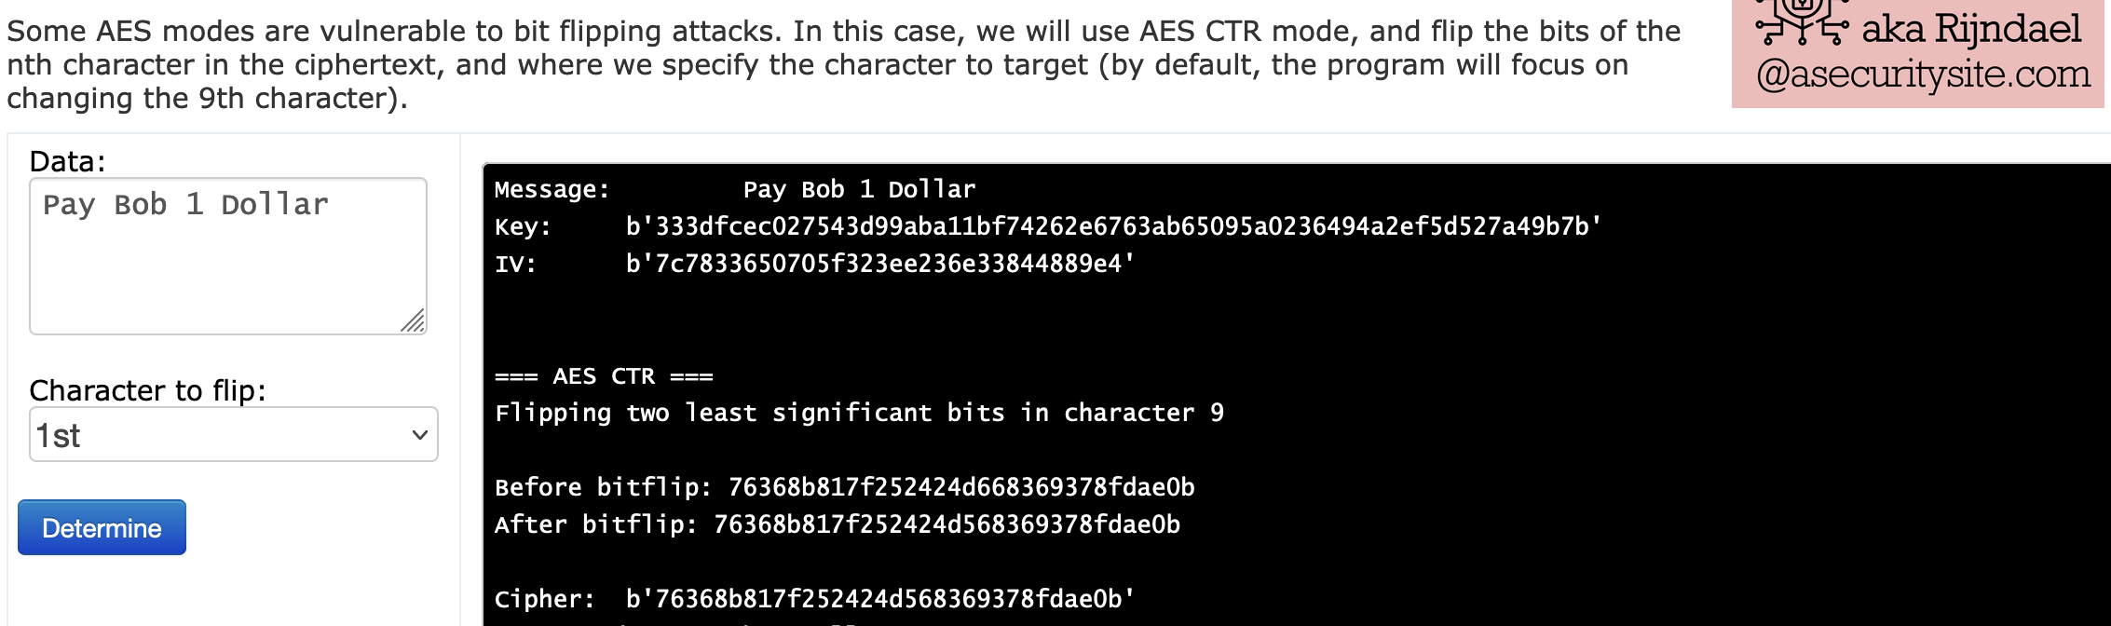
HMAC (Key Hash Message Authentication Code)
https://asecuritysite.com/aes/hashnew4a

Slide 39
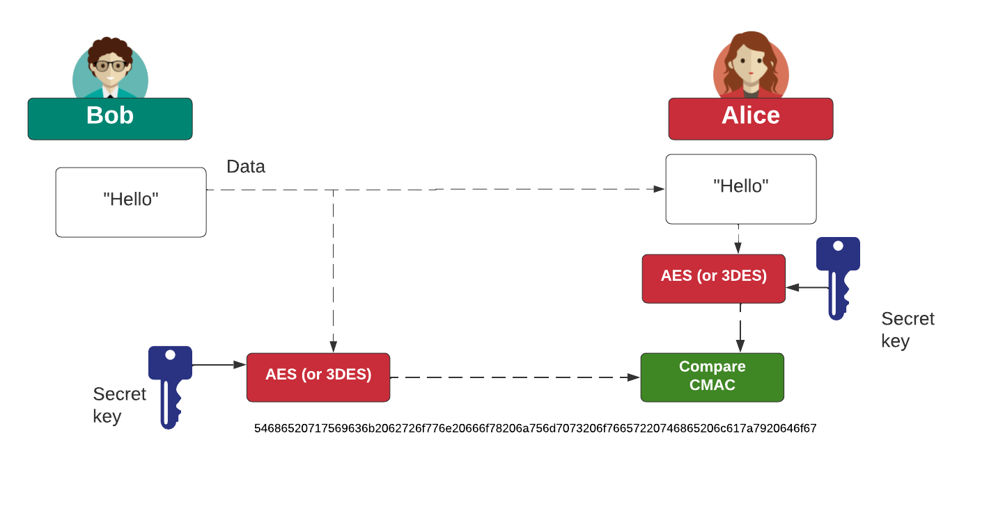
CMAC (Cipher MAC)
https://asecuritysite.com/golang/go_hmac

Slide 40
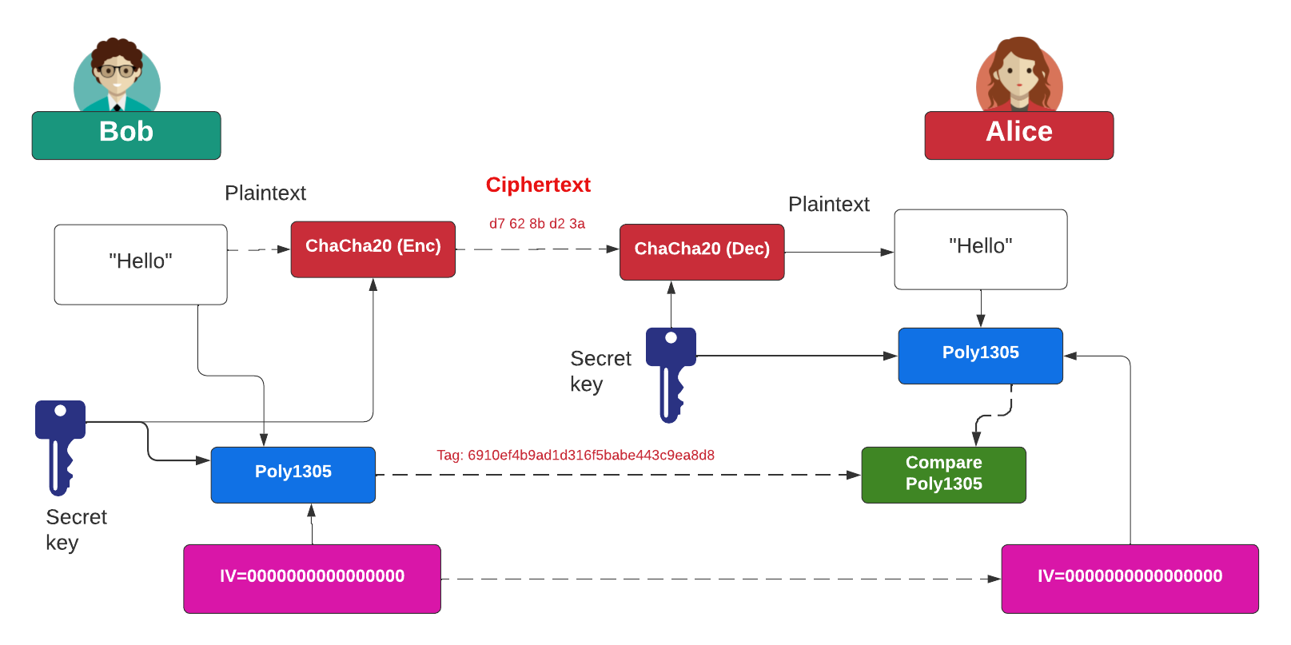
ChaCha20/Poly1305
https://asecuritysite.com/golang/go_hmac

Slide 41
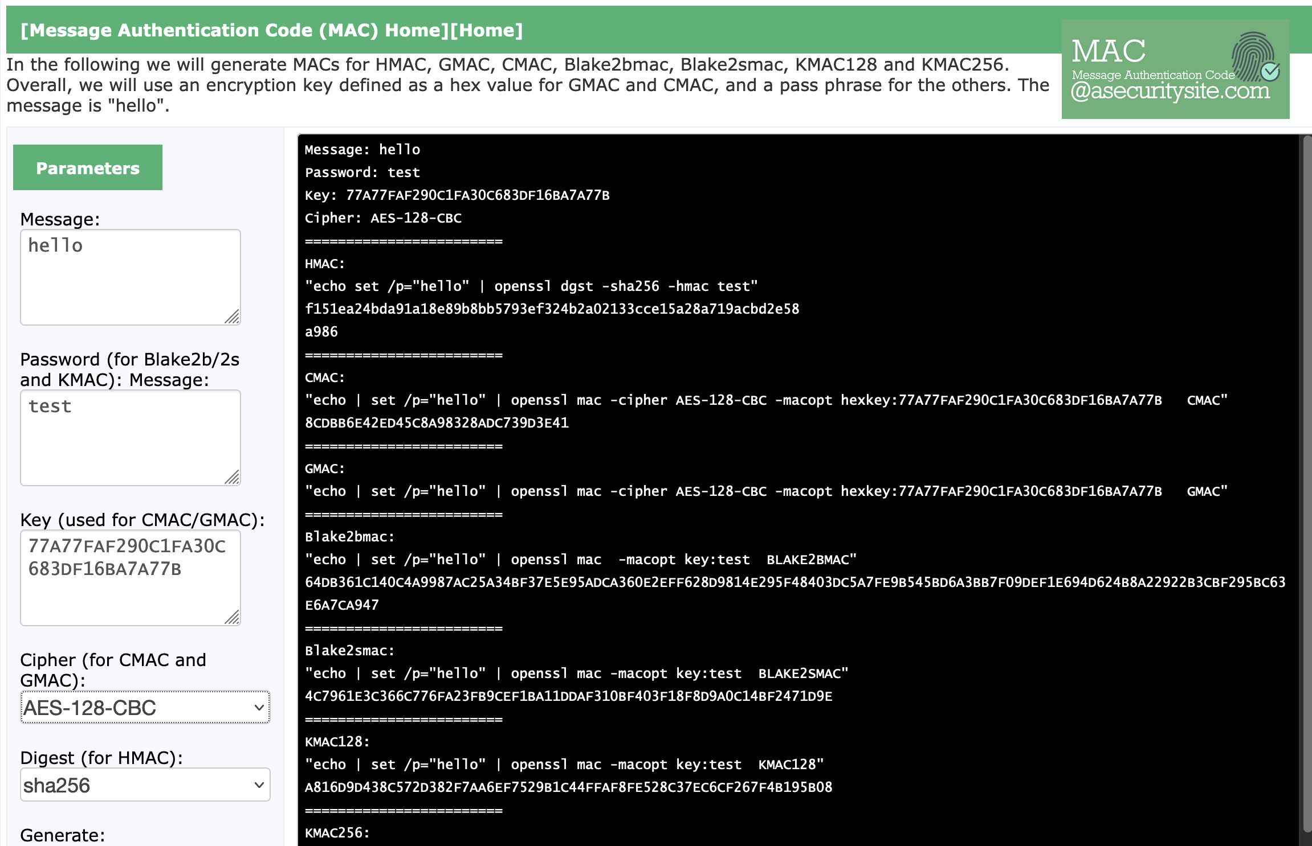
Generating MACs with OpenSSL
https://asecuritysite.com/mac/openssl_mac

Slide 42
Cryptography: KDF
Prof Bill Buchanan OBE FRSE
https://asecuritysite.com/kdf
Fundamentals
Symmetric Key
Hashing
MAC
KDF
Public Key
Key Exchange
Signatures
Digital Certificates

Slide 43
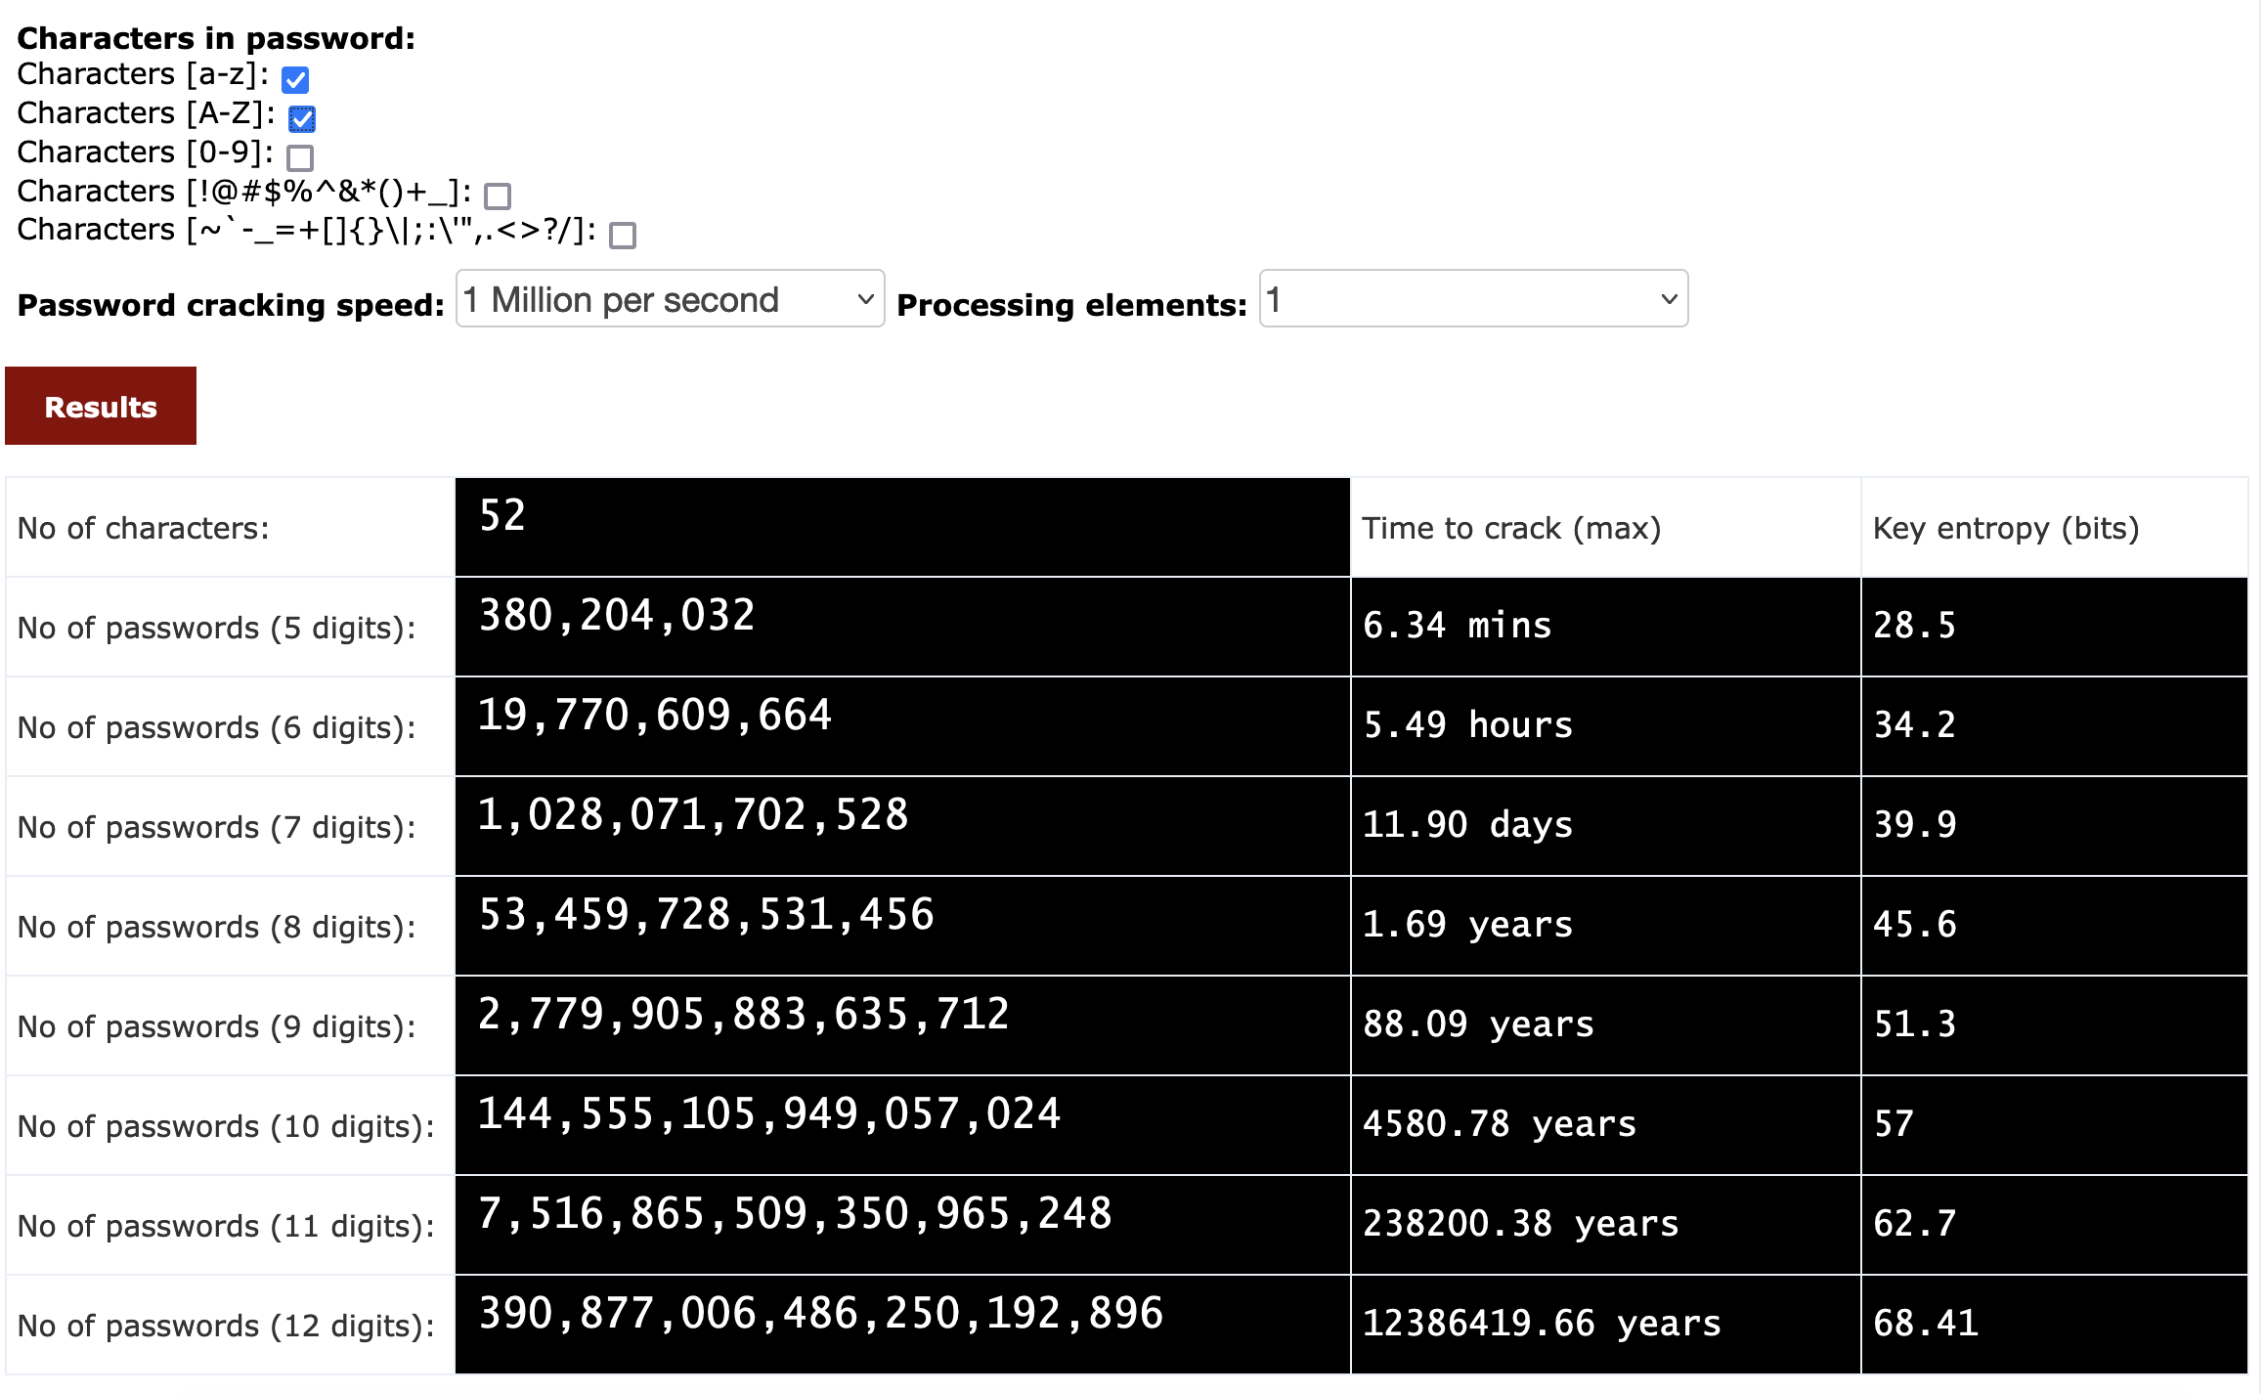
Keys Generated By Passwords With Brute Force
https://asecuritysite.com/encryption/passes

Slide 44
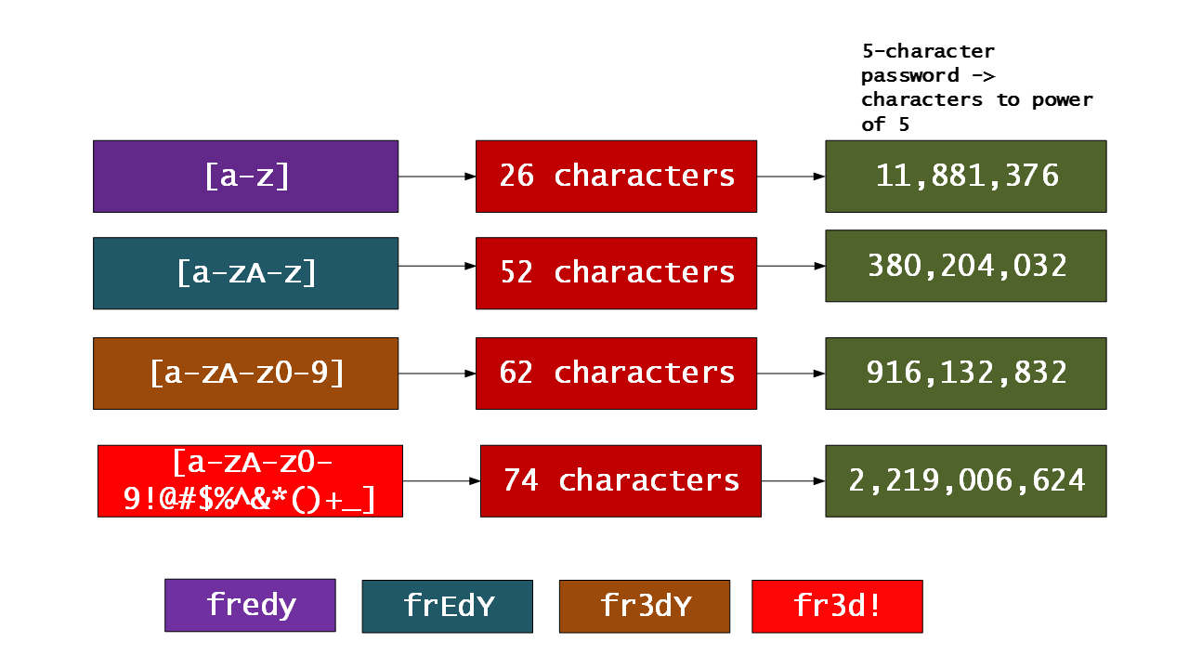
Keys Generated By Passwords With Brute Force
https://asecuritysite.com/encryption/passes

Slide 45
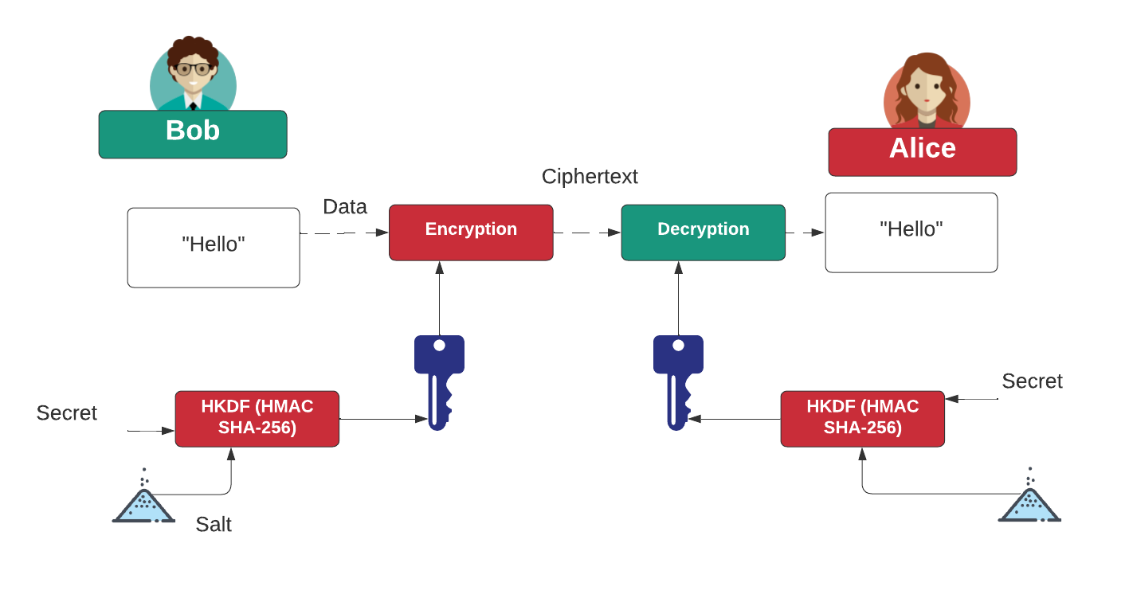
HKDF (HMAC Key Derivation Function)
https://asecuritysite.com/pbkdf2/hashnew3

Slide 46
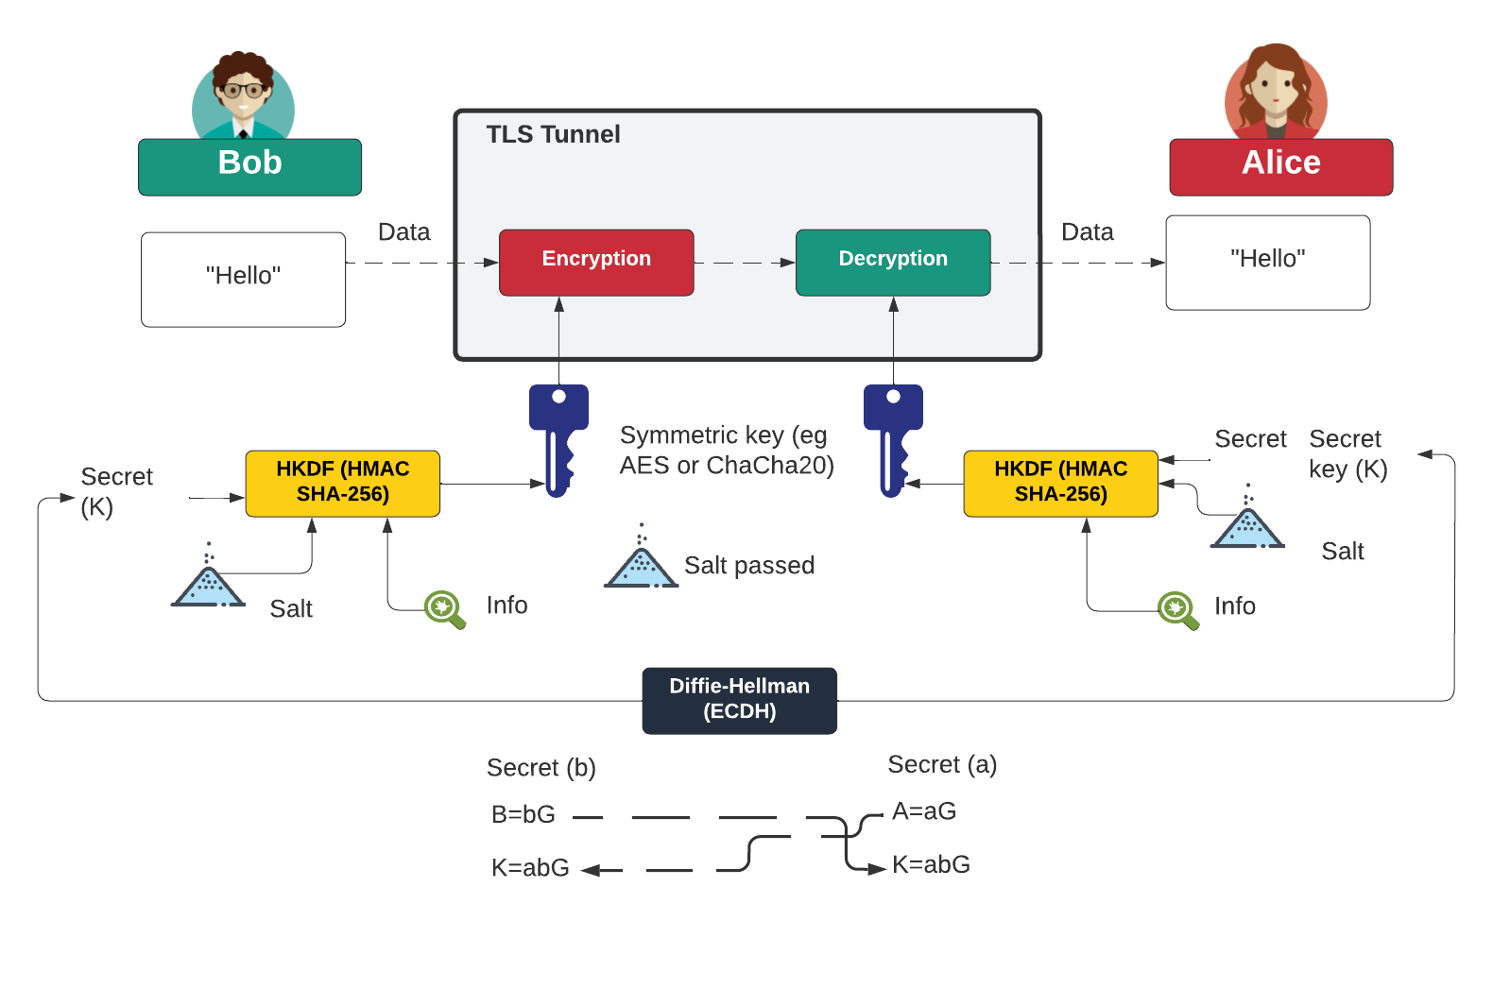
TLS Setup of Symmetric Key

Slide 47
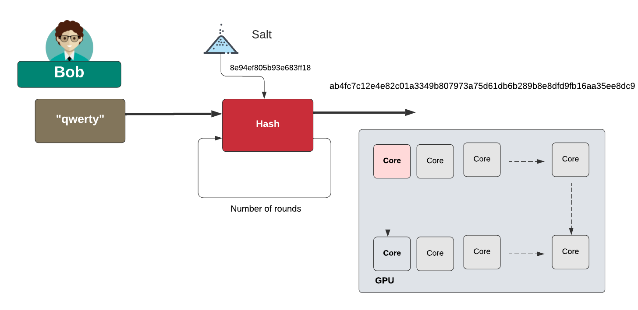
Slowing down hashing
https://asecuritysite.com/hash/htest

Slide 48
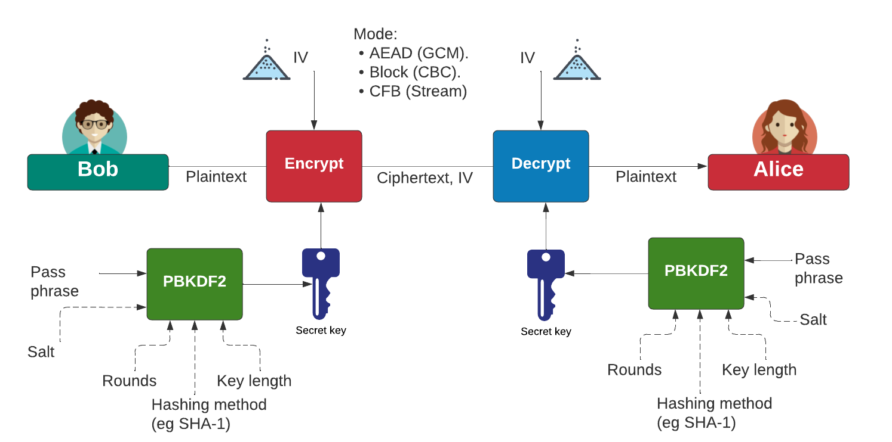
PBKDF2
https://asecuritysite.com/pbkdf2/PBKDF2_2

Slide 49
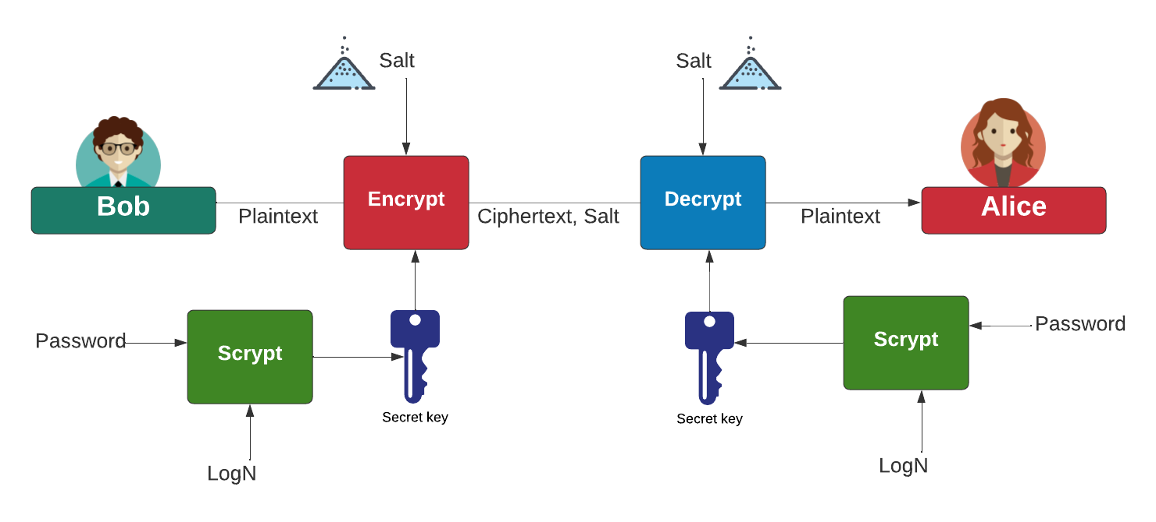
scrypt
https://asecuritysite.com/pbkdf2/kdf

Slide 50
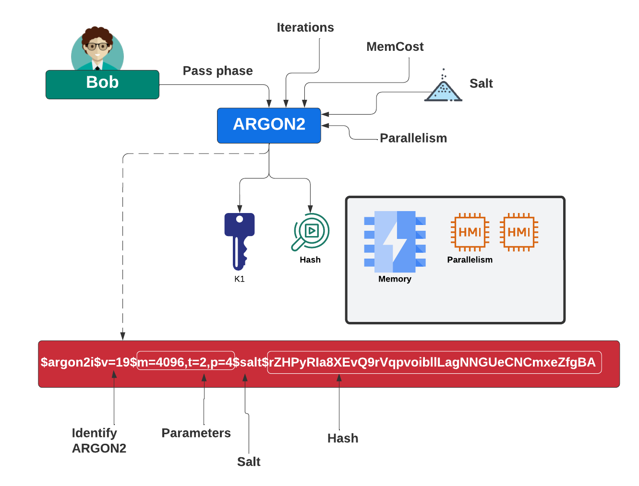
Argon2
https://asecuritysite.com/encryption/argon

Slide 51
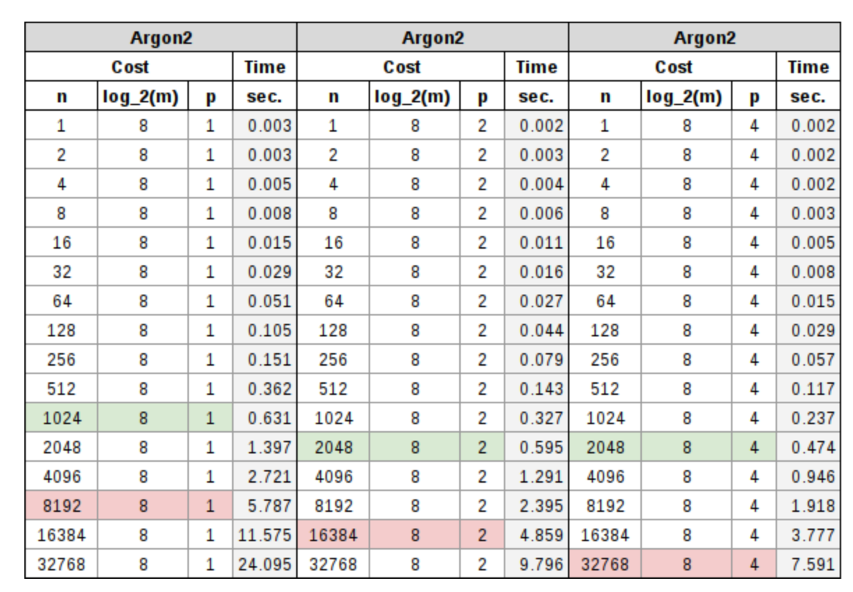
Argon2
The parameters include:
Password (P): Defines the password bytes to be hashed
Salt (S): Defines the bytes to be used for salting.
Parallelism (p): Defines the number of thread that are required for the parallelism.
TagLength (T): Define the number of bytes to return for the hash.
MemorySizeKB (m): Amount of memory (in KB) to use.
A sample run is:
Message: abc Hash: $argon2i$v=19$m=8,t=1,p=1$x/3yHil0MIE$RDL1Jw
https://asecuritysite.com/encryption/argon

Slide 52
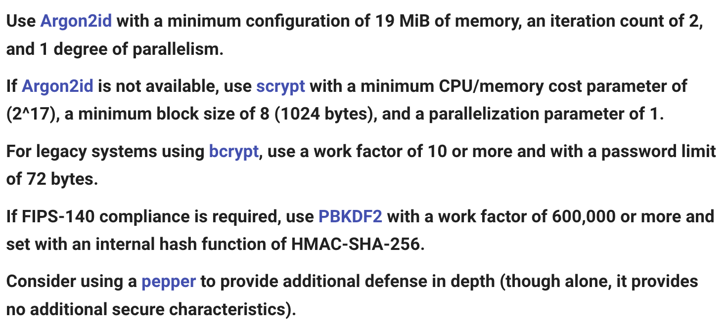
OWASP
https://cheatsheetseries.owasp.org/cheatsheets/Password_Storage_Cheat_Sheet.html

Slide 53
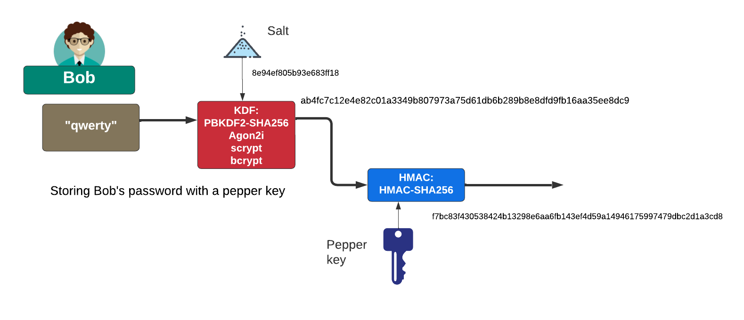
Using a Pepper Key

Slide 54
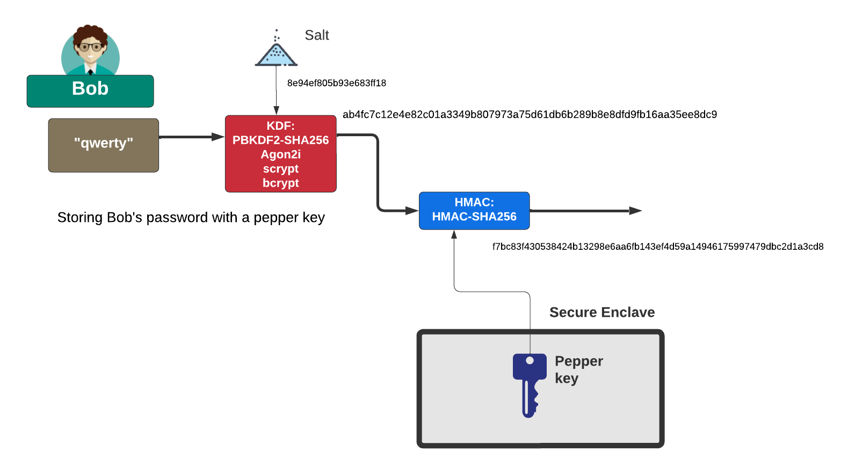
Using a Pepper Key

Slide 55
Cryptography: Public Key
Prof Bill Buchanan OBE FRSE
https://asecuritysite.com/rsa
Fundamentals
Symmetric Key
Hashing
MAC
KDF
Public Key
Key Exchange
Signatures
Digital Certificates
https://asecuritysite.com/ecc

Slide 56

Public Key

Slide 57




Public Key

Slide 58

Public Key
ECC was co-invented by Neal Koblitz and Victor S Miller
ElGamal was invented by Tahir ElGamal
https://asecuritysite.com/golang/go_elgamal

Slide 59

RSA
https://asecuritysite.com/golang/go_elgamal

Slide 60

RSA

Slide 61

Optimal Asymmetric Encryption Padding (OAEP) padding
https://asecuritysite.com/rsa/go_rsa2

Slide 62

RSA: PKCS1v15 padding
https://asecuritysite.com/rsa/go_rsa3

Slide 63

ElGamal
https://asecuritysite.com/golang/go_elgamal

Slide 64

ElGamal
https://asecuritysite.com/golang/go_elgamal

Slide 65

Crypto – Elliptic Curve
Y^2=x^3−3x+5
https://asecuritysite.com/ecc/plot05

Slide 66





Crypto – Elliptic Curve
Private key: 0xc9f4f55bdeb5ba0bd337f2dbc952a5439e20ef9af6203d25d014e7102d86aaeeL
Public key: 0xc44370819cb3b7b57b2aa7edf550a9a5410c234d27aff497458bbbfec8b6a327, 0x52a1a3e222cd89cbd2764b69bd9b0ea5c4fd6ca28861e1f2140eeff9c2e76487
G: (5066263022277343669578718895168534326250603453777594175500187360389116729240L, 32670510020758816978083085130507043184471273380659243275938904335757337482424L)

Slide 67

Elliptic Curve
A: 0
B: 7
Prime number: 37
Elliptic curve is: y²=x³+ 7
Finding the first 20 points
( 3 , 16 ) ( 4 , 16 ) ( 5 , 13 ) ( 6 , 1 ) ( 8 , 1 ) ( 9 , 12 ) ( 12 , 12 ) ( 13 , 13 ) ( 16 , 12 ) ( 17 , 6 ) ( 18 , 17 ) ( 19 , 13 ) ( 22 , 6 ) ( 23 , 1 ) ( 24 , 17 ) ( 30 , 16 ) ( 32 , 17 ) ( 35 , 6 ) ( 37 , 9 ) ( 40 , 16 ) ( 41 , 16 ) [Link]
https://asecuritysite.com/ecc/ecc_pointsv

Slide 68

Elliptic Curve Types
https://asecuritysite.com/ecc/ecc_types

Slide 69

Crypto – Elliptic Curve Types
https://asecuritysite.com/ecc/ecc_types

Slide 70

ECC Keys
https://asecuritysite.com/ecc/ecc_types

Slide 71

ECC Parameters
https://asecuritysite.com/ecc/ecc_types

Slide 72

Crypto – Compressed Point
https://asecuritysite.com/ecc/js_ethereum2

Slide 73


Key Formats
https://asecuritysite.com/openssh/openssh

Slide 74

Key Formats: Distinguished Encoding Rules (DER) encoding of ASN.1
(Abstract Syntax Notation One).
https://asecuritysite.com/digitalcert/sigs3

Slide 75


Object identifier (OID)
https://asecuritysite.com/powershell/oid

Slide 76

Key Ring

Slide 77
Cryptography: Key Exchange
Prof Bill Buchanan OBE FRSE
https://asecuritysite.com/keyexchange
Fundamentals
Symmetric Key
Hashing
MAC
KDF
Public Key
Key Exchange
Signatures
Digital Certificates

Slide 78

Key Exchange Problem

Slide 79

The Diffie-Hellman Method

Slide 80

The Diffie-Hellman Method

Slide 81

Picking g and p
Y = g^{x} (mod p)
Let’s try p=11
Picking G

Slide 82

Eve-in-the-Middle

Slide 83
Diffie-Hellman Generation
C:\> openssl dhparam -out dhparams.pem 768 –text
C:\> type dhparams.pem
Diffie-Hellman-Parameters: (768 bit)
prime:
00:d0:37:c2:95:64:02:ea:12:2b:51:50:a2:84:6c:
71:6a:3e:2c:a9:80:e2:65:b2:a5:ee:77:26:22:31:
66:9e:fc:c8:09:94:e8:9d:f4:cd:bf:d2:37:b2:fb:
b8:38:2c:87:28:38:dc:95:24:73:06:d3:d9:1f:af:
78:01:10:6a:7e:56:4e:7b:ee:b4:8d:6b:4d:b5:9b:
93:c6:f1:74:60:01:0d:96:7e:85:ca:b8:1f:f7:bc:
43:b7:40:4d:4e:87:e3
generator: 2 (0x2)
-----BEGIN DH PARAMETERS-----
MGYCYQDQN8KVZALqEitRUKKEbHFqPiypgOJlsqXudyYiMWae/MgJlOid9M2/0jey
+7g4LIcoONyVJHMG09kfr3gBEGp+Vk577rSNa021m5PG8XRgAQ2WfoXKuB/3vEO3
QE1Oh+MCAQI=
-----END DH PARAMETERS-----
DH Group 5: 1,536 bit prime.
DH Group 2: 1,024 bit prime.
DH Group 1: 768-bit prime.

Slide 84

Elliptic Curve Diffie Hellman
Common curves: secp256r1 (P256), secp256k1 (Bitcoin) and Curve 25519

Slide 85

Key Exchange with Public Key

Slide 86
Key Exchange
Forward secrecy (FS), which means that a comprise of the long-term keys will not compromise any previous session keys. A leakage of the public key of the server would cause all the sessions which used this specific public key to be compromised. FS thus aims to overcome this by making sure that all the sessions keys could not be compromised, even though the long-term key was compromised.
Ephemeral. With some key exchange methods, the same key will be generated if the same parameters are used on either side. This can cause problems as an intruder could guess the key, or even where the key was static and never changed. With ephemeral methods, a different key is used for each connection, and, again, the leakage of any long-term would not cause all the associated session keys to be breached.

Slide 87
Cryptography: Digital Signatures
Prof Bill Buchanan OBE FRSE
https://asecuritysite.com/signatures
Fundamentals
Symmetric Key
Hashing
MAC
KDF
Public Key
Key Exchange
Signatures
Digital Certificates

Slide 88

Digital Signatures

Slide 89

Digital Signatures

Slide 90

Digital Signatures

Slide 91

Digital Signatures

Slide 92

Digital Signatures - RSA

Slide 93


RSA Digital Signatures – PSS and PKCS1v15
https://asecuritysite.com/rsa/go_rsa4
https://asecuritysite.com/rsa/go_rsa5

Slide 94

ECDSA
https://asecuritysite.com/ecdsa/ecdsa3

Slide 95

ECDSA: Leak of nonce
https://asecuritysite.com/cracking/ecd2

Slide 96

EdDSA
https://asecuritysite.com/golang/ecdsa_rs2
https://asecuritysite.com/golang/ecdsa_rs

Slide 97

Cloud Keys and Signatures
https://asecuritysite.com/aws/lab09

Slide 98
Cryptography: Digital Certificates
Prof Bill Buchanan OBE FRSE
https://asecuritysite.com/digitalcert
Fundamentals
Symmetric Key
Hashing
MAC
KDF
Public Key
Key Exchange
Signatures
Digital Certificates

Slide 99


Digital Cerificates

Slide 100


Slide 101


Slide 102


Slide 103


Slide 104


Slide 105




Slide 106



Slide 107
PEM
PKCS#7
-----BEGIN CERTIFICATE-----
MIIEwTCCA6mgAwIBAgIRAO93GGFLfHwOCAAAAAAucZgwDQYJKoZIhvcNAQELBQAw
QjELMAkGA1UEBhMCVVMxHjAcBgNVBAoTFUdvb2dsZSBUcnVzdCBTZXJ2aWNlczET
MBEGA1UEAxMKR1RTIENBIDFPMTAeFw0yMDAyMTIxMTQ3NDFaFw0yMDA1MDYxMTQ3
NDFaMGgxCzAJBgNVBAYTAlVTMRMwEQYDVQQIEwpDYWxpZm9ybmlhMRYwFAYDVQQH
Ew1Nb3VudGFpbiBWaWV3MRMwEQYDVQQKEwpHb29nbGUgTExDMRcwFQYDVQQDEw53
d3cuZ29vZ2xlLmNvbTBZMBMGByqGSM49AgEGCCqGSM49AwEHA0IABCzzLJYFJb8W
TpQxWL0TySDvfEWCkMe7l81CFspT60knl13YILNdTM22sUwPycyogKjBSaQZ9Axi
hCeGEAiJkbejggJVMIICUTAOBgNVHQ8BAf8EBAMCB4AwEwYDVR0lBAwwCgYIKwYB
BQUHAwEwDAYDVR0TAQH/BAIwADAdBgNVHQ4EFgQU9Ty3t90o7UW9+Hc6kv/j9511
BBwwHwYDVR0jBBgwFoAUmNH4bhDrz5vsYJ8YkBug630J/SswZAYIKwYBBQUHAQEE
WDBWMCcGCCsGAQUFBzABhhtodHRwOi8vb2NzcC5wa2kuZ29vZy9ndHMxbzEwKwYI
KwYBBQUHMAKGH2h0dHA6Ly9wa2kuZ29vZy9nc3IyL0dUUzFPMS5jcnQwGQYDVR0R
BBIwEIIOd3d3Lmdvb2dsZS5jb20wIQYDVR0gBBowGDAIBgZngQwBAgIwDAYKKwYB
BAHWeQIFAzAvBgNVHR8EKDAmMCSgIqAghh5odHRwOi8vY3JsLnBraS5nb29nL0dU
UzFPMS5jcmwwggEFBgorBgEEAdZ5AgQCBIH2BIHzAPEAdgCyHgXMi6LNiiBOh2b5
K7mKJSBna9r6cOeySVMt74uQXgAAAXA5cNqwAAAEAwBHMEUCIQCojKtzOe8l1JYK
HmKnbt1puqT4AE3peMVAVk/WeWGp1QIgBvRMbNkwF6i8+JVv3CfTHKvFd8e00+GY
PbXJZb1drKEAdwBep3P531bA57U2SH3QSeAyepGaDIShEhKEGHWWgXFFWAAAAXA5
cNrLAAAEAwBIMEYCIQCQSONppELPODh65oFT5ZAGsSQz4FsjNNZedgS7WqzLnQIh
AMAru0QUuoE3RWngfhI6W7n1kxkEmd0vSZTe6+Ql+JVuMA0GCSqGSIb3DQEBCwUA
A4IBAQCDU8CVusGstVk1lAmrtg3DyYhNV1UnKyLk3RrHKumwYz5mC25bWGoLVKvv
pwxBN3zA329/9JZq0mnn0vmPMxjTDvh9sVQ7g4znwha/KJfzL8AZKUdldD9O+hDO
tlHtqVqITZPCAI/ANvbHdZiMEePB8eA+oTiw2ucChqLlsop5Mio8ckg7aXG4/QfC
AIDbvkoffK44rs4UEpsaqGe9QqMJjTuO7ZCZrFd1m3geq2ARKPHgPoPM6UbDdqgO
TNQo9C0F5ZlOkOgV/qshvpTO4YzE7TB2U571eYEqNXH48syVx8XSk3P7FjM7FIZ2
IzbJSEipZJm8DsP10fFXpToIn+zK
-----END CERTIFICATE-----
-----BEGIN PKCS7-----
MIIE8gYJKoZIhvcNAQcCoIIE4zCCBN8CAQExADALBgkqhkiG9w0BBwGgggTFMIIE
wTCCA6mgAwIBAgIRAO93GGFLfHwOCAAAAAAucZgwDQYJKoZIhvcNAQELBQAwQjEL
MAkGA1UEBhMCVVMxHjAcBgNVBAoTFUdvb2dsZSBUcnVzdCBTZXJ2aWNlczETMBEG
A1UEAxMKR1RTIENBIDFPMTAeFw0yMDAyMTIxMTQ3NDFaFw0yMDA1MDYxMTQ3NDFa
MGgxCzAJBgNVBAYTAlVTMRMwEQYDVQQIEwpDYWxpZm9ybmlhMRYwFAYDVQQHEw1N
b3VudGFpbiBWaWV3MRMwEQYDVQQKEwpHb29nbGUgTExDMRcwFQYDVQQDEw53d3cu
Z29vZ2xlLmNvbTBZMBMGByqGSM49AgEGCCqGSM49AwEHA0IABCzzLJYFJb8WTpQx
WL0TySDvfEWCkMe7l81CFspT60knl13YILNdTM22sUwPycyogKjBSaQZ9AxihCeG
EAiJkbejggJVMIICUTAOBgNVHQ8BAf8EBAMCB4AwEwYDVR0lBAwwCgYIKwYBBQUH
AwEwDAYDVR0TAQH/BAIwADAdBgNVHQ4EFgQU9Ty3t90o7UW9+Hc6kv/j9511BBww
HwYDVR0jBBgwFoAUmNH4bhDrz5vsYJ8YkBug630J/SswZAYIKwYBBQUHAQEEWDBW
MCcGCCsGAQUFBzABhhtodHRwOi8vb2NzcC5wa2kuZ29vZy9ndHMxbzEwKwYIKwYB
BQUHMAKGH2h0dHA6Ly9wa2kuZ29vZy9nc3IyL0dUUzFPMS5jcnQwGQYDVR0RBBIw
EIIOd3d3Lmdvb2dsZS5jb20wIQYDVR0gBBowGDAIBgZngQwBAgIwDAYKKwYBBAHW
eQIFAzAvBgNVHR8EKDAmMCSgIqAghh5odHRwOi8vY3JsLnBraS5nb29nL0dUUzFP
MS5jcmwwggEFBgorBgEEAdZ5AgQCBIH2BIHzAPEAdgCyHgXMi6LNiiBOh2b5K7mK
JSBna9r6cOeySVMt74uQXgAAAXA5cNqwAAAEAwBHMEUCIQCojKtzOe8l1JYKHmKn
bt1puqT4AE3peMVAVk/WeWGp1QIgBvRMbNkwF6i8+JVv3CfTHKvFd8e00+GYPbXJ
Zb1drKEAdwBep3P531bA57U2SH3QSeAyepGaDIShEhKEGHWWgXFFWAAAAXA5cNrL
AAAEAwBIMEYCIQCQSONppELPODh65oFT5ZAGsSQz4FsjNNZedgS7WqzLnQIhAMAr
u0QUuoE3RWngfhI6W7n1kxkEmd0vSZTe6+Ql+JVuMA0GCSqGSIb3DQEBCwUAA4IB
AQCDU8CVusGstVk1lAmrtg3DyYhNV1UnKyLk3RrHKumwYz5mC25bWGoLVKvvpwxB
N3zA329/9JZq0mnn0vmPMxjTDvh9sVQ7g4znwha/KJfzL8AZKUdldD9O+hDOtlHt
qVqITZPCAI/ANvbHdZiMEePB8eA+oTiw2ucChqLlsop5Mio8ckg7aXG4/QfCAIDb
vkoffK44rs4UEpsaqGe9QqMJjTuO7ZCZrFd1m3geq2ARKPHgPoPM6UbDdqgOTNQo
9C0F5ZlOkOgV/qshvpTO4YzE7TB2U571eYEqNXH48syVx8XSk3P7FjM7FIZ2IzbJ
SEipZJm8DsP10fFXpToIn+zKoQAxAA==
-----END PKCS7-----
X.509 Certificate (PEM)
X.509 Certificate (DER)
X.509 Certificate (PKCS#7)
PKCS#1 v2 - Padding for Public Key
PKCS #7 v1.5 - Cryptography Message Syntax
PKCS 10 v1.7 - Certificate Request Standard.
Base64
Base64
openssl x509 -outform der -in www-google-com.pem -out google.crt
openssl pkcs12 -export -in server.pem -out keystore.pkcs12
Binary
DER
CER

Slide 108

Digital Cerificates

Slide 109


Slide 110


Slide 111


Slide 112


Slide 113


Slide 114


Slide 115


Slide 116


Slide 117


Slide 118


Slide 119


Slide 120


Slide 121


Slide 122


Slide 123


Slide 124


Slide 125


Slide 126

Overview

Slide 127

Trent

Slide 128


ECDSA

Slide 129

RSA Signatures

Slide 130

Schnorr Signatures – used with EdDSA

Slide 131
The Four Signatures
ECDSA. Example.
EdDSA (Ed25519). Example.
RSA PKCS#1 v1.5. Example.
RSA PSS (Probabilistic signature scheme). Example.

Slide 132
Cryptography
Prof Bill Buchanan OBE FRSE
https://asecuritysite.com
Fundamentals
Symmetric Key
Hashing
MAC
KDF
Public Key
Key Exchange
Signatures
Digital Certificates

